Slide 1
Coupledline Compiled Data

Slide 2
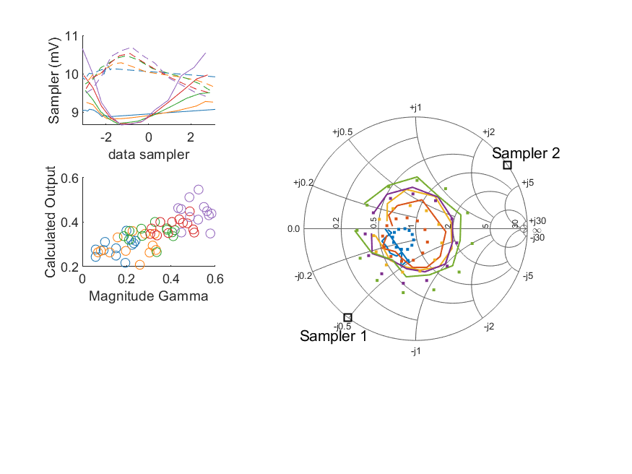
Coupled Line Performance At 10.60 GHz, 16.000000 dBm Output Power 1.00 V mean sampler bias
Sampler Av
Sampler 1: 230.474
Sampler 2: 230.474
Sampler Offset (rather than -1)
-4.9928411510321906
Goodness Of fit
0.27750939133529551
Sampler 1 Range
0.0019920916400000006
Sampler 2 Range
0.0012764781300000014
DUT output dBm Mean
15.977000064873708
DUT input dBm Mean
16.536866404249761
RMS Error
0.10716275461204321

Slide 3
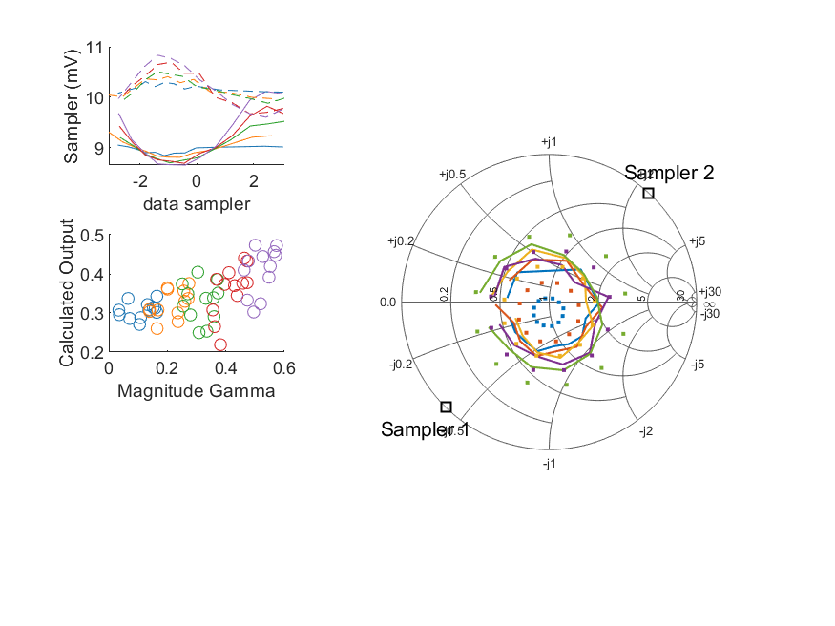
Coupled Line Performance At 10.70 GHz, 16.000000 dBm Output Power 1.00 V mean sampler bias
Sampler Av
Sampler 1: 231.763
Sampler 2: 231.763
Sampler Offset (rather than -1)
-5.0374580279795804
Goodness Of fit
0.33347980500253049
Sampler 1 Range
0.0014599805300000001
Sampler 2 Range
0.0012302323799999997
DUT output dBm Mean
16.006374434490748
DUT input dBm Mean
16.432863244257156
RMS Error
0.12688866849592353

Slide 4
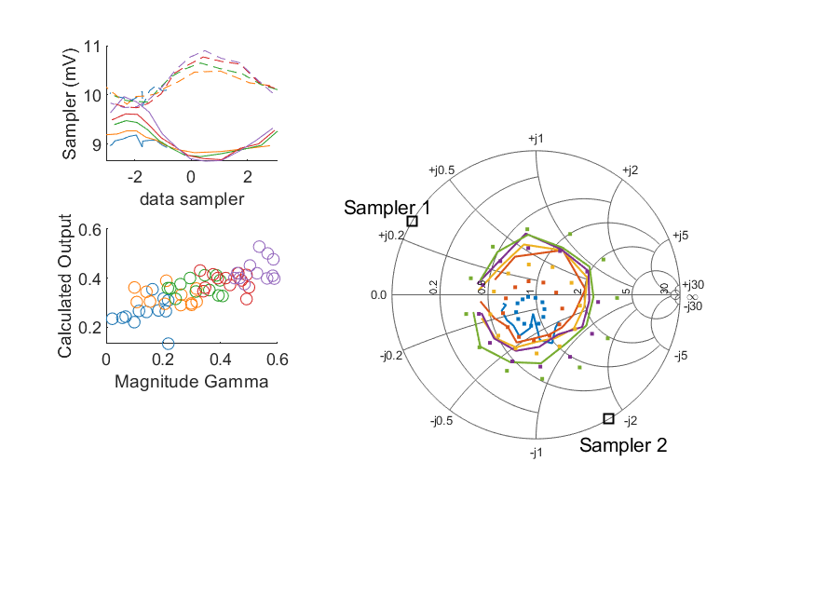
Coupled Line Performance At 10.80 GHz, 16.000000 dBm Output Power 1.00 V mean sampler bias
Sampler Av
Sampler 1: 300.000
Sampler 2: 300.000
Sampler Offset (rather than -1)
-5.154370676450541
Goodness Of fit
0.3127118254018672
Sampler 1 Range
0.0013072972599999996
Sampler 2 Range
0.0011553791300000001
DUT output dBm Mean
15.992523832146315
DUT input dBm Mean
16.441726796609444
RMS Error
0.11301951682014939

Slide 5
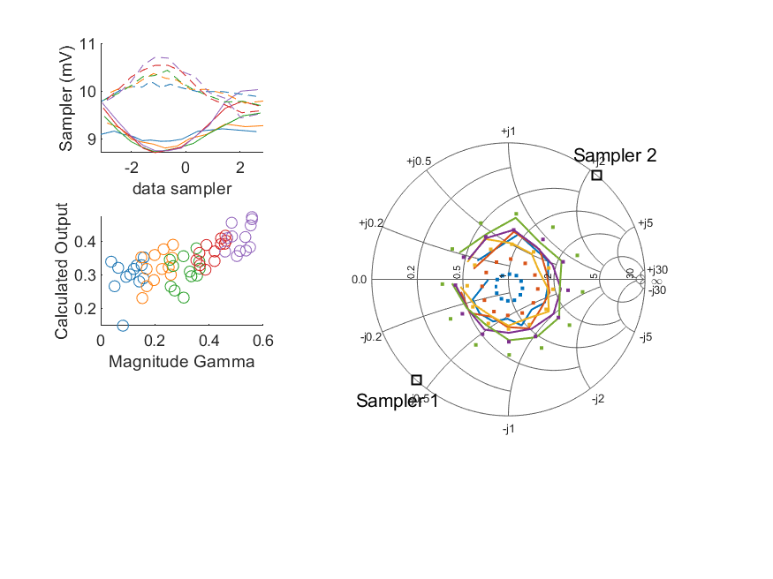
Coupled Line Performance At 10.90 GHz, 16.000000 dBm Output Power 1.00 V mean sampler bias
Sampler Av
Sampler 1: 237.336
Sampler 2: 237.336
Sampler Offset (rather than -1)
-5.0668952047004909
Goodness Of fit
0.29134674483864276
Sampler 1 Range
0.0013203513900000002
Sampler 2 Range
0.00127373668
DUT output dBm Mean
15.981332574735848
DUT input dBm Mean
16.502310854756875
RMS Error
0.11880422380845083

Slide 6
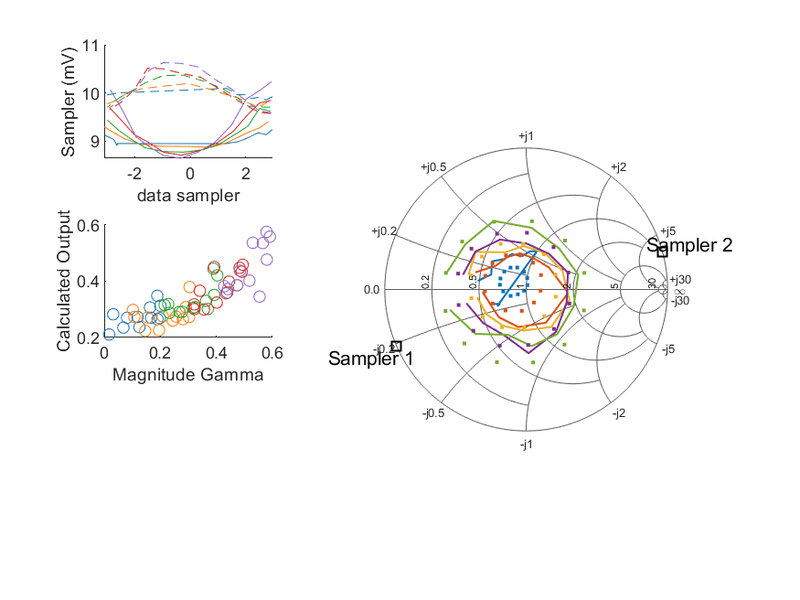
Coupled Line Performance At 11.00 GHz, 16.000000 dBm Output Power 1.00 V mean sampler bias
Sampler Av
Sampler 1: 300.000
Sampler 2: 300.000
Sampler Offset (rather than -1)
-5.2852053123720806
Goodness Of fit
0.17046904414237246
Sampler 1 Range
0.0015957080399999993
Sampler 2 Range
0.0010599288300000009
DUT output dBm Mean
16.016248211069591
DUT input dBm Mean
16.455437185062358
RMS Error
0.094768893113829092

Slide 7
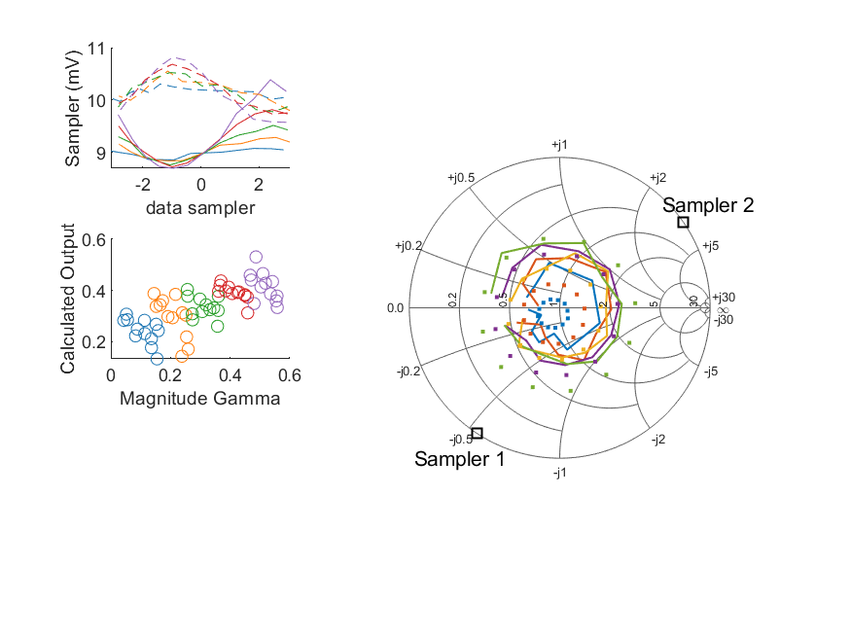
Coupled Line Performance At 11.10 GHz, 16.000000 dBm Output Power 1.00 V mean sampler bias
Sampler Av
Sampler 1: 274.190
Sampler 2: 274.190
Sampler Offset (rather than -1)
-5.4421926379583292
Goodness Of fit
0.31348441131638249
Sampler 1 Range
0.0016887020999999999
Sampler 2 Range
0.0012441351300000007
DUT output dBm Mean
16.030705172026845
DUT input dBm Mean
16.515711671013904
RMS Error
0.11682629894816884

Slide 8
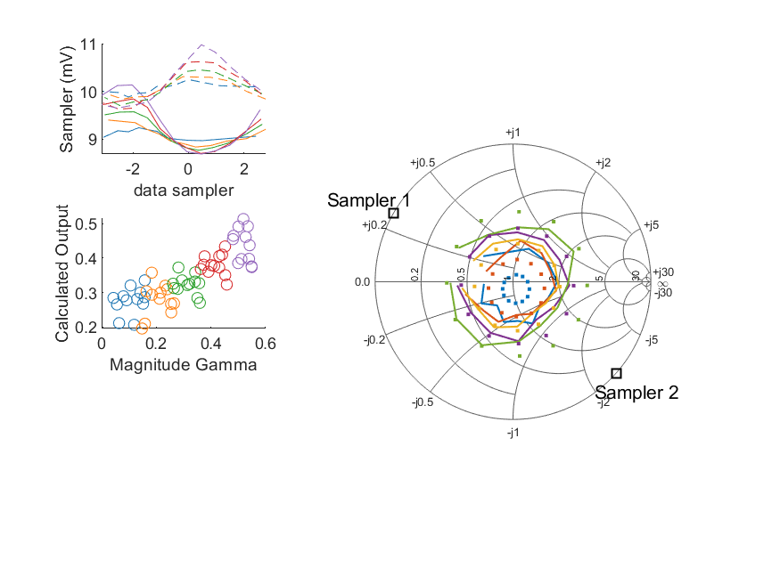
Coupled Line Performance At 11.20 GHz, 16.000000 dBm Output Power 1.00 V mean sampler bias
Sampler Av
Sampler 1: 277.524
Sampler 2: 277.524
Sampler Offset (rather than -1)
-5.4613475587346052
Goodness Of fit
0.22150958712904584
Sampler 1 Range
0.0014482751200000001
Sampler 2 Range
0.0013505879599999999
DUT output dBm Mean
16.018695872269742
DUT input dBm Mean
16.536042265498892
RMS Error
0.10416404087090562

Slide 9
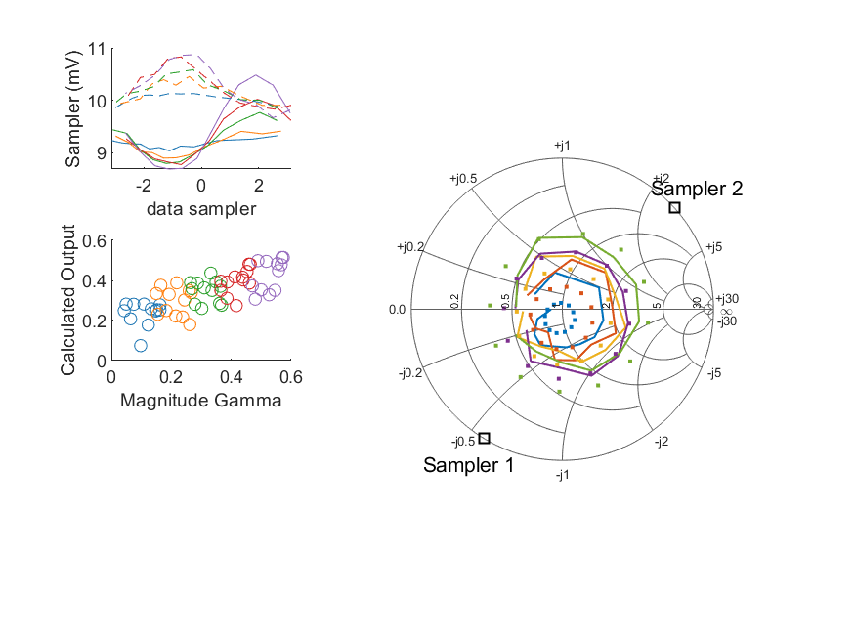
Coupled Line Performance At 11.30 GHz, 16.000000 dBm Output Power 1.00 V mean sampler bias
Sampler Av
Sampler 1: 168.872
Sampler 2: 168.872
Sampler Offset (rather than -1)
-4.4976057232664193
Goodness Of fit
0.26037015903611627
Sampler 1 Range
0.0017959361399999992
Sampler 2 Range
0.0012089034299999999
DUT output dBm Mean
16.019020540766405
DUT input dBm Mean
16.521409250157678
RMS Error
0.10667915602199654

Slide 10
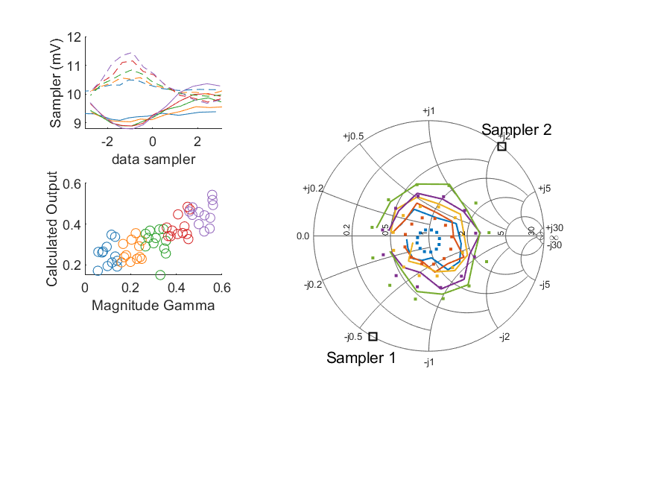
Coupled Line Performance At 11.40 GHz, 16.000000 dBm Output Power 1.00 V mean sampler bias
Sampler Av
Sampler 1: 275.480
Sampler 2: 275.480
Sampler Offset (rather than -1)
-5.558769909861569
Goodness Of fit
0.18985644186173478
Sampler 1 Range
0.0015747005700000004
Sampler 2 Range
0.0017707691399999996
DUT output dBm Mean
16.0865275767421
DUT input dBm Mean
16.594647363906169
RMS Error
0.097365190152626957

Slide 11
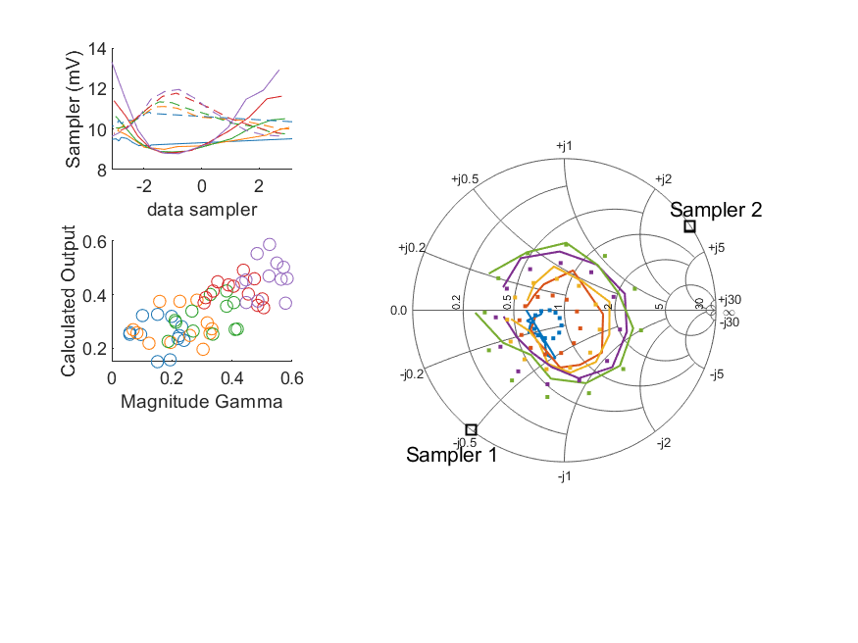
Coupled Line Performance At 10.60 GHz, 18.000000 dBm Output Power 1.00 V mean sampler bias
Sampler Av
Sampler 1: 108.609
Sampler 2: 108.609
Sampler Offset (rather than -1)
-2.8235153084819165
Goodness Of fit
0.2634887328684189
Sampler 1 Range
0.0045181483200000001
Sampler 2 Range
0.0023147161899999998
DUT output dBm Mean
17.959935464873706
DUT input dBm Mean
18.522906070916424
RMS Error
0.10366314397849355

Slide 12
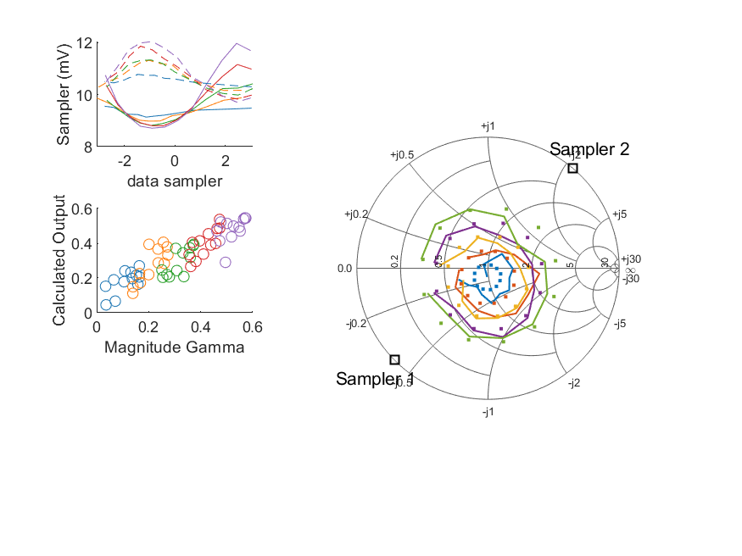
Coupled Line Performance At 10.70 GHz, 18.000000 dBm Output Power 1.00 V mean sampler bias
Sampler Av
Sampler 1: 170.148
Sampler 2: 170.148
Sampler Offset (rather than -1)
-4.1833248750622154
Goodness Of fit
0.12885114171100281
Sampler 1 Range
0.003257606750000001
Sampler 2 Range
0.0023261220199999998
DUT output dBm Mean
17.983129701157413
DUT input dBm Mean
18.413109244257157
RMS Error
0.074456037734347447

Slide 13
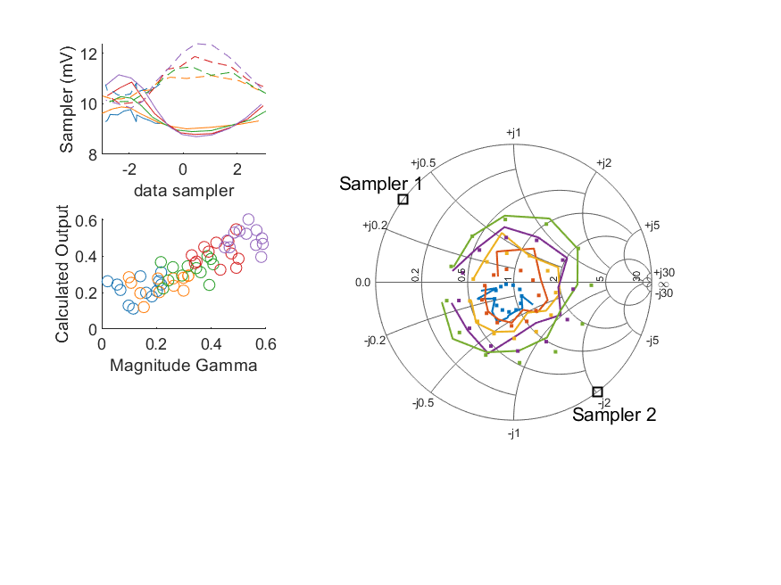
Coupled Line Performance At 10.80 GHz, 18.000000 dBm Output Power 1.00 V mean sampler bias
Sampler Av
Sampler 1: 260.159
Sampler 2: 260.159
Sampler Offset (rather than -1)
-4.8284064671786826
Goodness Of fit
0.18319034727318995
Sampler 1 Range
0.0024560667400000003
Sampler 2 Range
0.0025483097600000008
DUT output dBm Mean
17.97668296547965
DUT input dBm Mean
18.430521963276114
RMS Error
0.085268923384878681

Slide 14
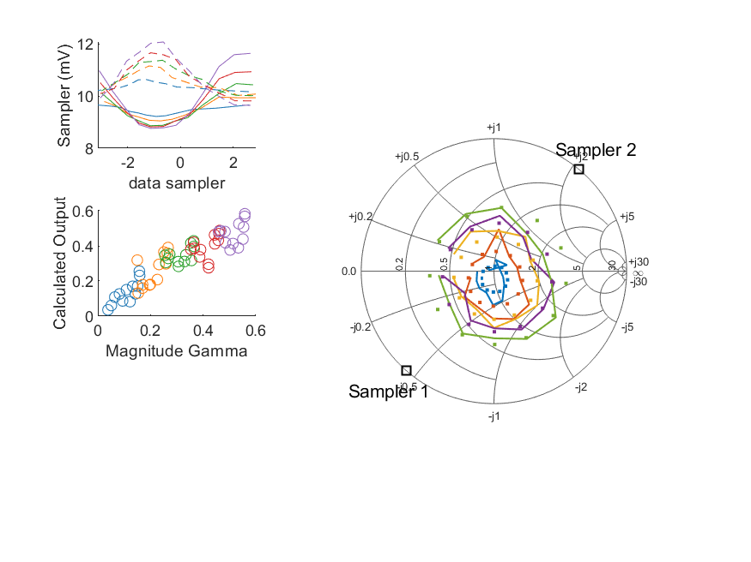
Coupled Line Performance At 10.90 GHz, 18.000000 dBm Output Power 1.00 V mean sampler bias
Sampler Av
Sampler 1: 186.820
Sampler 2: 186.820
Sampler Offset (rather than -1)
-4.4644800144133949
Goodness Of fit
0.12368938367230929
Sampler 1 Range
0.0028734214899999999
Sampler 2 Range
0.0024285747199999999
DUT output dBm Mean
17.963245474735846
DUT input dBm Mean
18.48621218809021
RMS Error
0.066148029299999869

Slide 15
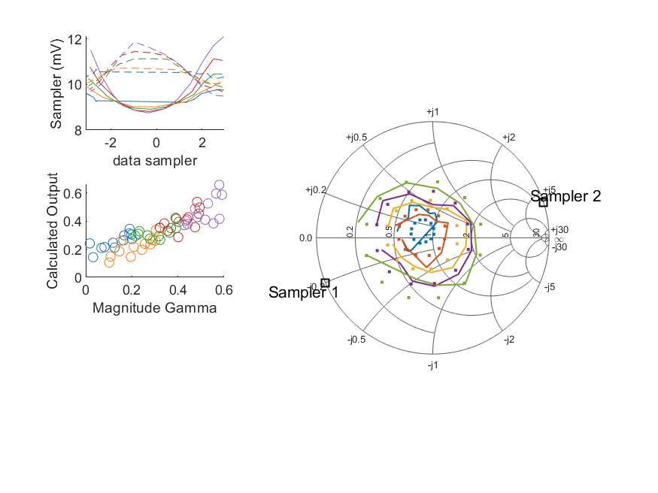
Coupled Line Performance At 11.00 GHz, 18.000000 dBm Output Power 1.00 V mean sampler bias
Sampler Av
Sampler 1: 220.652
Sampler 2: 220.652
Sampler Offset (rather than -1)
-4.3043217185002831
Goodness Of fit
0.15010791523758171
Sampler 1 Range
0.0033468574999999997
Sampler 2 Range
0.0023843007199999995
DUT output dBm Mean
17.993140827736262
DUT input dBm Mean
18.435685851729023
RMS Error
0.080275874325812208

Slide 16
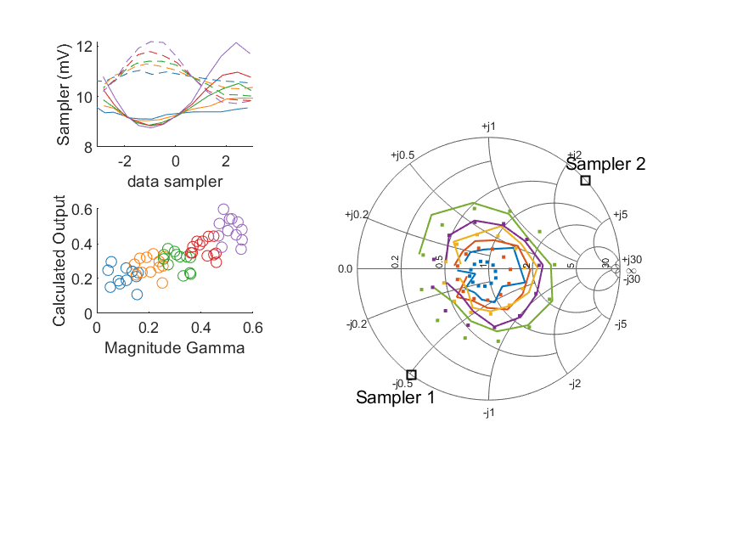
Coupled Line Performance At 11.10 GHz, 18.000000 dBm Output Power 1.00 V mean sampler bias
Sampler Av
Sampler 1: 201.884
Sampler 2: 201.884
Sampler Offset (rather than -1)
-4.4646538680979981
Goodness Of fit
0.1948291653986734
Sampler 1 Range
0.0033778816000000003
Sampler 2 Range
0.0024521222700000008
DUT output dBm Mean
18.008551772026845
DUT input dBm Mean
18.494773337680574
RMS Error
0.092691571237649387

Slide 17
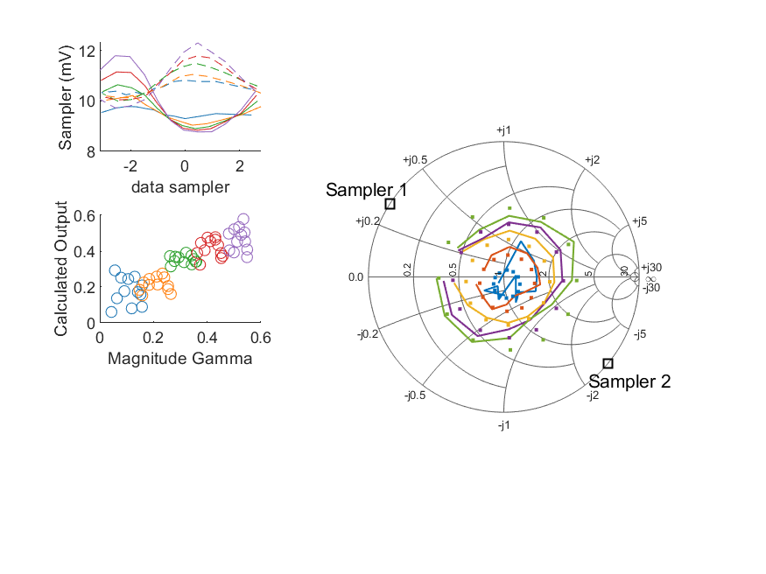
Coupled Line Performance At 11.20 GHz, 18.000000 dBm Output Power 1.00 V mean sampler bias
Sampler Av
Sampler 1: 198.374
Sampler 2: 198.374
Sampler Offset (rather than -1)
-4.5595395793564713
Goodness Of fit
0.14315363714832924
Sampler 1 Range
0.0030164019599999998
Sampler 2 Range
0.00257565274
DUT output dBm Mean
17.979728272269742
DUT input dBm Mean
18.499726432165559
RMS Error
0.080676853149773617

Slide 18
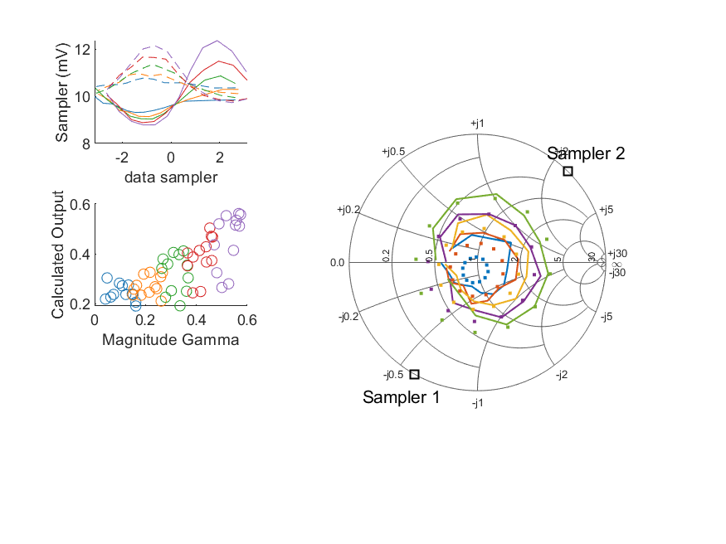
Coupled Line Performance At 11.30 GHz, 18.000000 dBm Output Power 1.00 V mean sampler bias
Sampler Av
Sampler 1: 136.589
Sampler 2: 136.589
Sampler Offset (rather than -1)
-3.6687458170014988
Goodness Of fit
0.2269111601054557
Sampler 1 Range
0.0035670805800000014
Sampler 2 Range
0.0024050320300000004
DUT output dBm Mean
17.990927457433074
DUT input dBm Mean
18.496039083491009
RMS Error
0.10398387581267554

Slide 19

Coupled Line Performance At 11.40 GHz, 18.000000 dBm Output Power 1.00 V mean sampler bias
Sampler Av
Sampler 1: 161.327
Sampler 2: 161.327
Sampler Offset (rather than -1)
-3.3858975878422171
Goodness Of fit
0.1889467964908759
Sampler 1 Range
0.0031735792000000002
Sampler 2 Range
0.0030626643799999999
DUT output dBm Mean
17.980571610075433
DUT input dBm Mean
18.489044197239501
RMS Error
0.086760960273581614

Slide 20
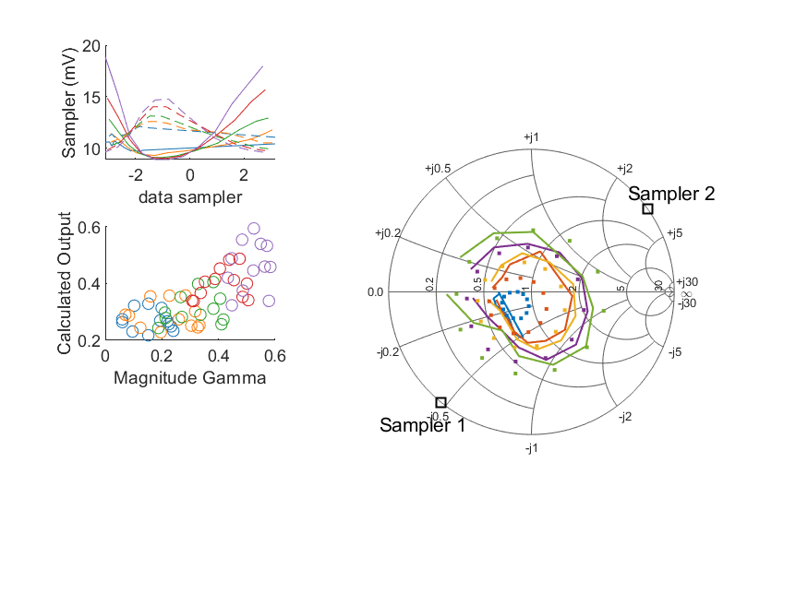
Coupled Line Performance At 10.60 GHz, 20.000000 dBm Output Power 1.00 V mean sampler bias
Sampler Av
Sampler 1: 50.052
Sampler 2: 50.052
Sampler Offset (rather than -1)
-1.4107923187418048
Goodness Of fit
0.26897833167997115
Sampler 1 Range
0.0099566262000000023
Sampler 2 Range
0.0051476555499999996
DUT output dBm Mean
19.95554321154037
DUT input dBm Mean
20.523195237583092
RMS Error
0.10602609614191341

Slide 21
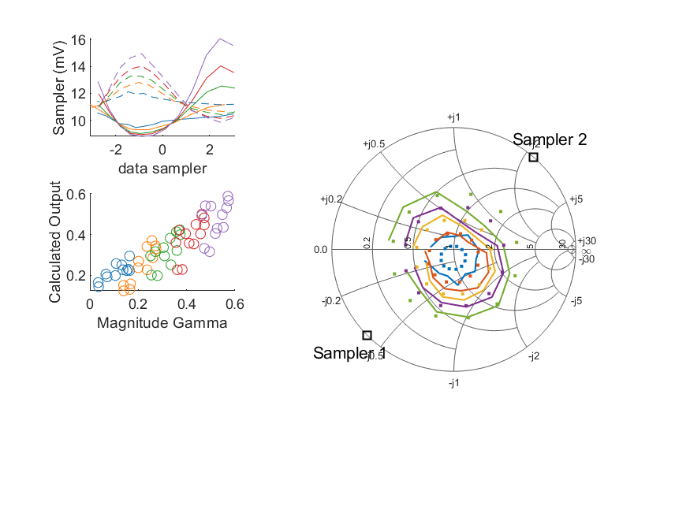
Coupled Line Performance At 10.70 GHz, 20.000000 dBm Output Power 1.00 V mean sampler bias
Sampler Av
Sampler 1: 72.775
Sampler 2: 72.775
Sampler Offset (rather than -1)
-2.003239480894401
Goodness Of fit
0.14612121996279173
Sampler 1 Range
0.0072822694399999992
Sampler 2 Range
0.0050997337400000009
DUT output dBm Mean
19.974841077824081
DUT input dBm Mean
20.410741244257153
RMS Error
0.079280110392821554

Slide 22
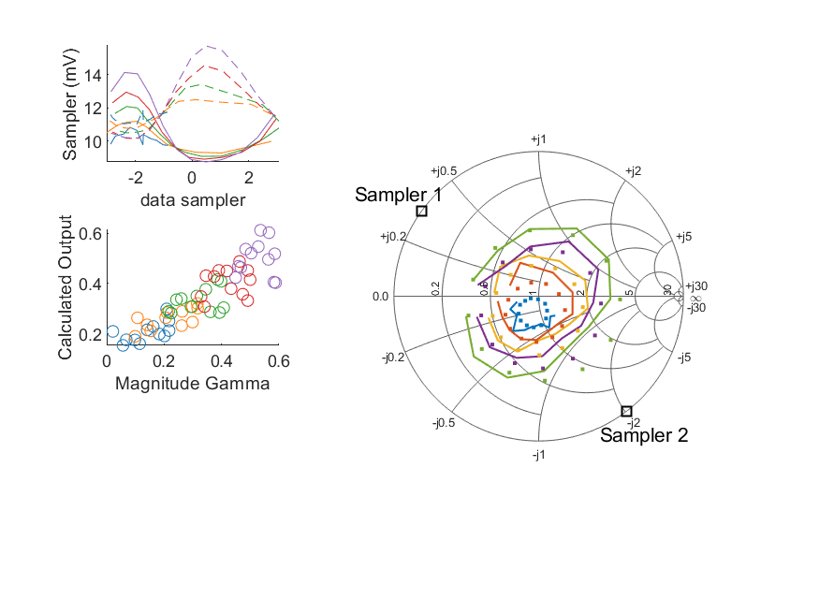
Coupled Line Performance At 10.80 GHz, 20.000000 dBm Output Power 1.00 V mean sampler bias
Sampler Av
Sampler 1: 111.577
Sampler 2: 111.577
Sampler Offset (rather than -1)
-2.1774623276325116
Goodness Of fit
0.1741985882226782
Sampler 1 Range
0.0053848223500000004
Sampler 2 Range
0.0055721395
DUT output dBm Mean
19.958332762146316
DUT input dBm Mean
20.41704446327611
RMS Error
0.076586257851212827

Slide 23
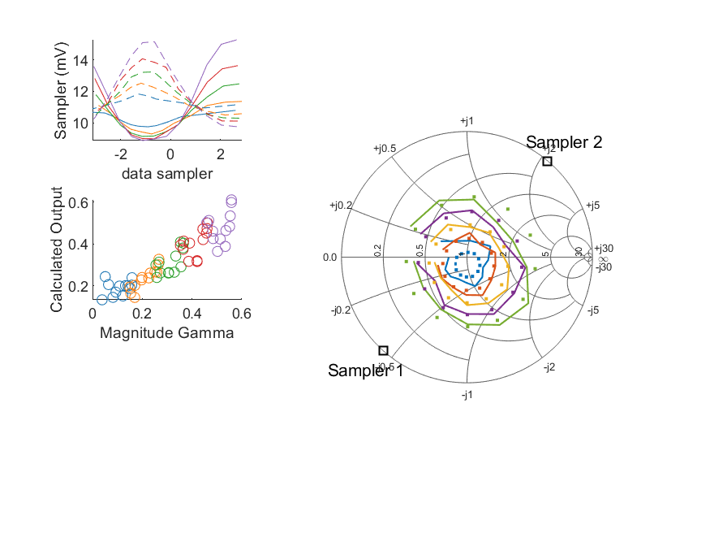
Coupled Line Performance At 10.90 GHz, 20.000000 dBm Output Power 1.00 V mean sampler bias
Sampler Av
Sampler 1: 80.745
Sampler 2: 80.745
Sampler Offset (rather than -1)
-2.088820866497791
Goodness Of fit
0.10194456967826362
Sampler 1 Range
0.0064317378999999997
Sampler 2 Range
0.0054199977599999997
DUT output dBm Mean
19.952081954735846
DUT input dBm Mean
20.47927202142354
RMS Error
0.063365791078601477

Slide 24
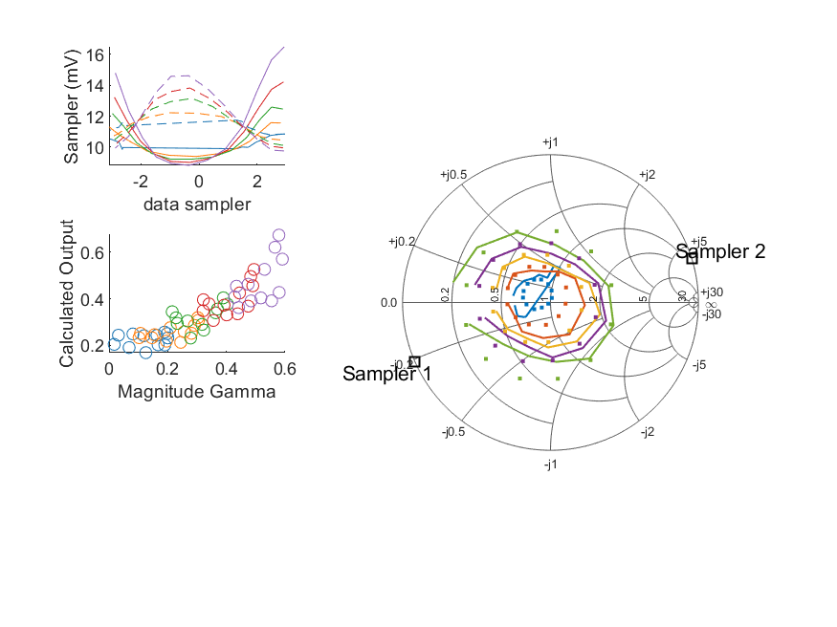
Coupled Line Performance At 11.00 GHz, 20.000000 dBm Output Power 1.00 V mean sampler bias
Sampler Av
Sampler 1: 84.640
Sampler 2: 84.640
Sampler Offset (rather than -1)
-1.7494298162187598
Goodness Of fit
0.14848417391294716
Sampler 1 Range
0.0076628337100000006
Sampler 2 Range
0.0048594526300000003
DUT output dBm Mean
19.977352177736257
DUT input dBm Mean
20.424458351729022
RMS Error
0.080124991861666287

Slide 25
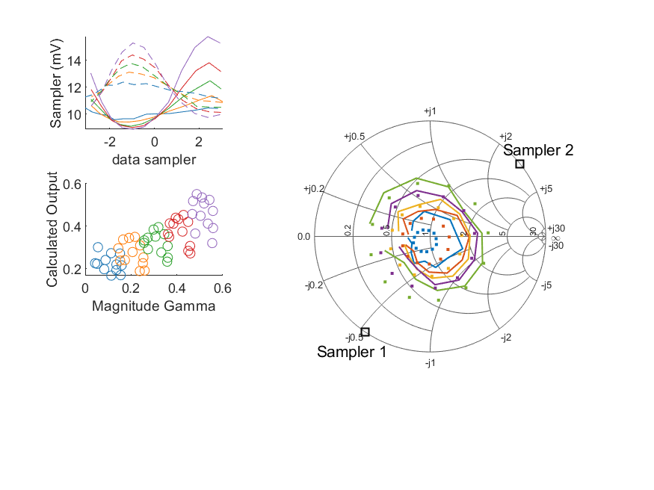
Coupled Line Performance At 11.10 GHz, 20.000000 dBm Output Power 1.00 V mean sampler bias
Sampler Av
Sampler 1: 75.750
Sampler 2: 75.750
Sampler Offset (rather than -1)
-1.7590329168045171
Goodness Of fit
0.24112618586597342
Sampler 1 Range
0.0068900518300000005
Sampler 2 Range
0.0055399417900000008
DUT output dBm Mean
19.994615322026846
DUT input dBm Mean
20.484890337680568
RMS Error
0.10214658491020304

Slide 26
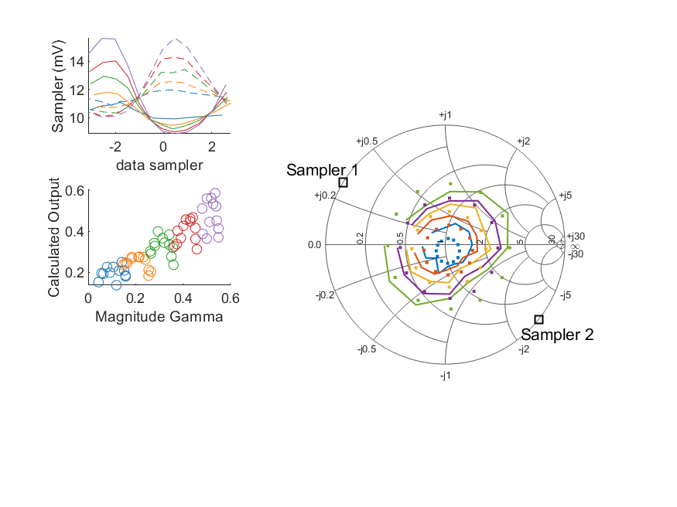
Coupled Line Performance At 11.20 GHz, 20.000000 dBm Output Power 1.00 V mean sampler bias
Sampler Av
Sampler 1: 80.148
Sampler 2: 80.148
Sampler Offset (rather than -1)
-1.9603813780407169
Goodness Of fit
0.15192629049122042
Sampler 1 Range
0.0067455398900000008
Sampler 2 Range
0.0056047476999999991
DUT output dBm Mean
19.96827742226974
DUT input dBm Mean
20.490608598832225
RMS Error
0.077365753953731298

Slide 27

Coupled Line Performance At 11.30 GHz, 20.000000 dBm Output Power 1.00 V mean sampler bias
Sampler Av
Sampler 1: 60.095
Sampler 2: 60.095
Sampler Offset (rather than -1)
-1.7620379685982672
Goodness Of fit
0.19650139838256009
Sampler 1 Range
0.0078562109700000011
Sampler 2 Range
0.0051166942600000005
DUT output dBm Mean
19.988452007433072
DUT input dBm Mean
20.497250916824342
RMS Error
0.096919798087490711

Slide 28
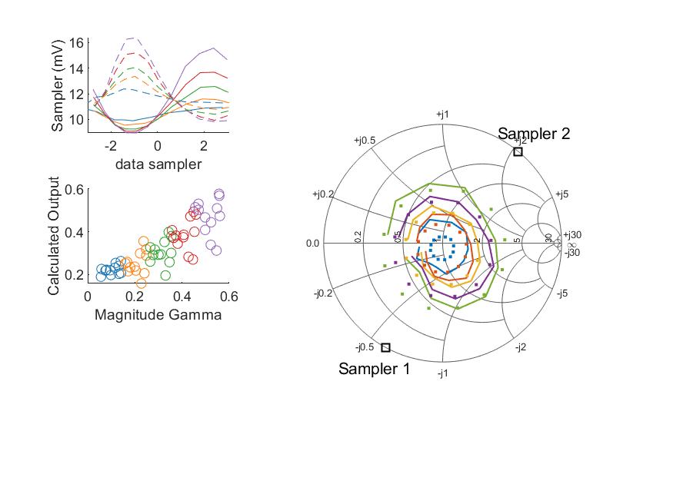
Coupled Line Performance At 11.40 GHz, 20.000000 dBm Output Power 1.00 V mean sampler bias
Sampler Av
Sampler 1: 77.248
Sampler 2: 77.248
Sampler Offset (rather than -1)
-1.7650561437211036
Goodness Of fit
0.17687531743800755
Sampler 1 Range
0.00660045821
Sampler 2 Range
0.006531292670000001
DUT output dBm Mean
19.970183193408769
DUT input dBm Mean
20.479517863906167
RMS Error
0.087417453107273765

Slide 29
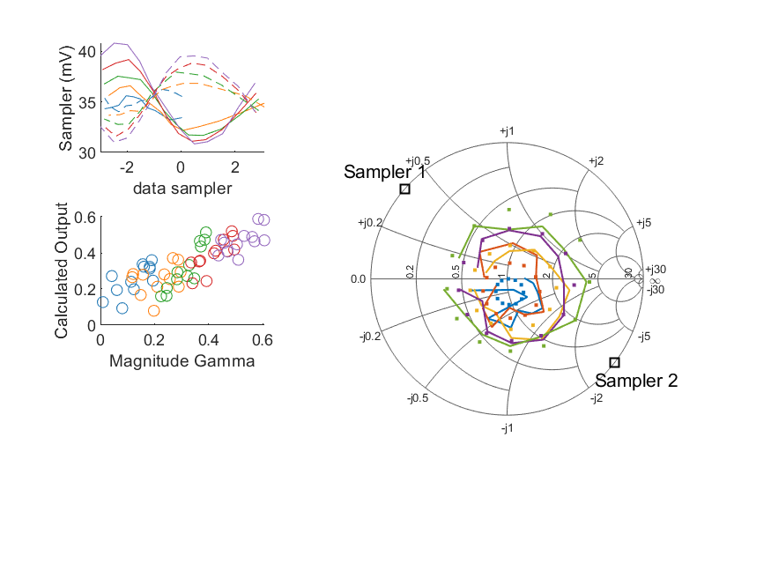
Coupled Line Performance At 10.50 GHz, 12.000000 dBm Output Power 1.25 V mean sampler bias
Sampler Av
Sampler 1: 85.696
Sampler 2: 85.696
Sampler Offset (rather than -1)
-6.6247497110863476
Goodness Of fit
0.18686080016309869
Sampler 1 Range
0.0099674870000000006
Sampler 2 Range
0.0085527537999999965
DUT output dBm Mean
11.976901648866415
DUT input dBm Mean
12.353844049913482
RMS Error
0.097867840529957409

Slide 30
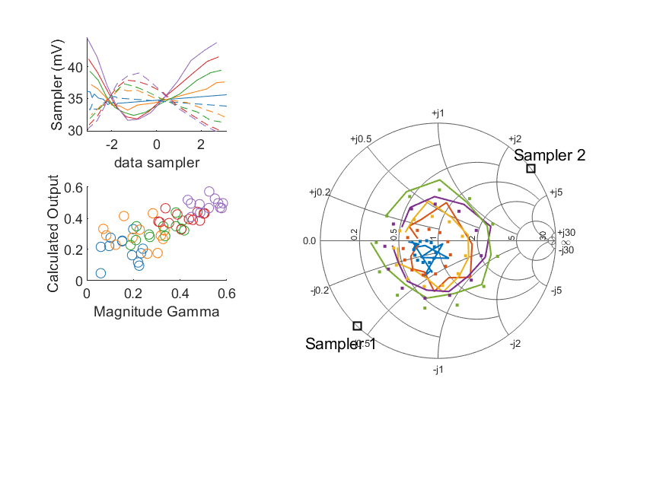
Coupled Line Performance At 10.60 GHz, 12.000000 dBm Output Power 1.25 V mean sampler bias
Sampler Av
Sampler 1: 68.932
Sampler 2: 68.932
Sampler Offset (rather than -1)
-5.5725825968680098
Goodness Of fit
0.20565151634186013
Sampler 1 Range
0.013187516100000005
Sampler 2 Range
0.0093026511999999978
DUT output dBm Mean
11.958798698207039
DUT input dBm Mean
12.513336070916427
RMS Error
0.10355974423208594

Slide 31
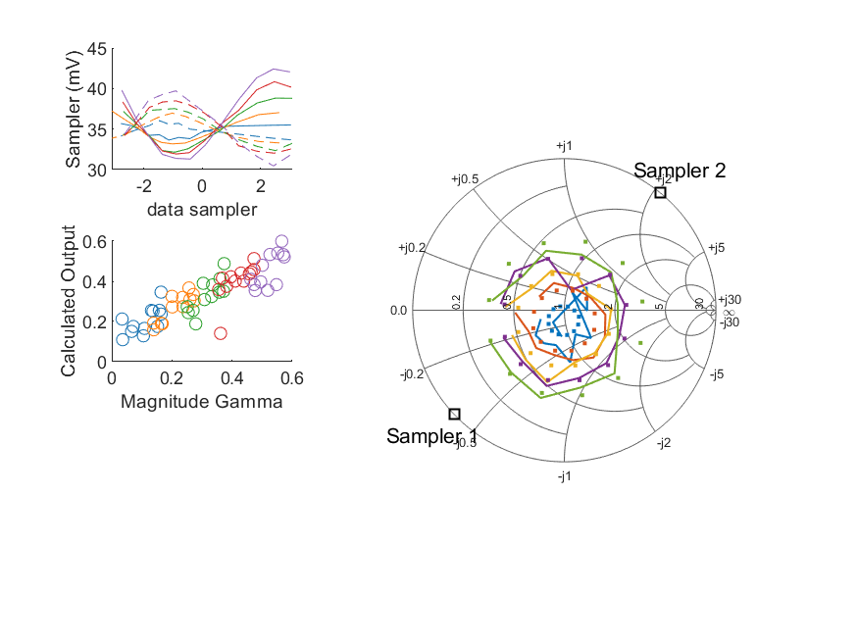
Coupled Line Performance At 10.70 GHz, 12.000000 dBm Output Power 1.25 V mean sampler bias
Sampler Av
Sampler 1: 68.555
Sampler 2: 68.555
Sampler Offset (rather than -1)
-5.7865481737018971
Goodness Of fit
0.14912766024793001
Sampler 1 Range
0.011118621100000003
Sampler 2 Range
0.0092697392999999996
DUT output dBm Mean
11.997153467824084
DUT input dBm Mean
12.418875077590487
RMS Error
0.085143137945510011

Slide 32
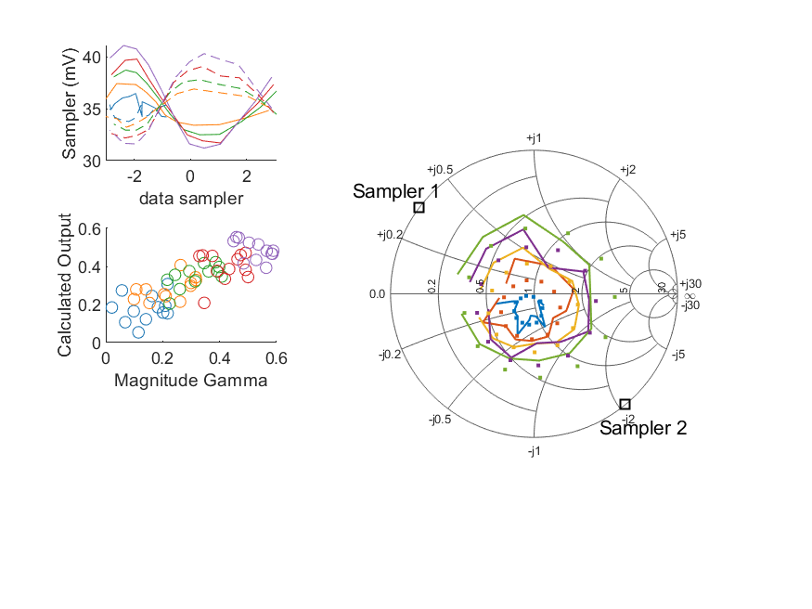
Coupled Line Performance At 10.80 GHz, 12.000000 dBm Output Power 1.25 V mean sampler bias
Sampler Av
Sampler 1: 83.290
Sampler 2: 83.290
Sampler Offset (rather than -1)
-5.891526954407678
Goodness Of fit
0.22500041928405112
Sampler 1 Range
0.0098907387999999964
Sampler 2 Range
0.0087076105000000042
DUT output dBm Mean
11.975856498812982
DUT input dBm Mean
12.420220629942779
RMS Error
0.087405073967323679

Slide 33
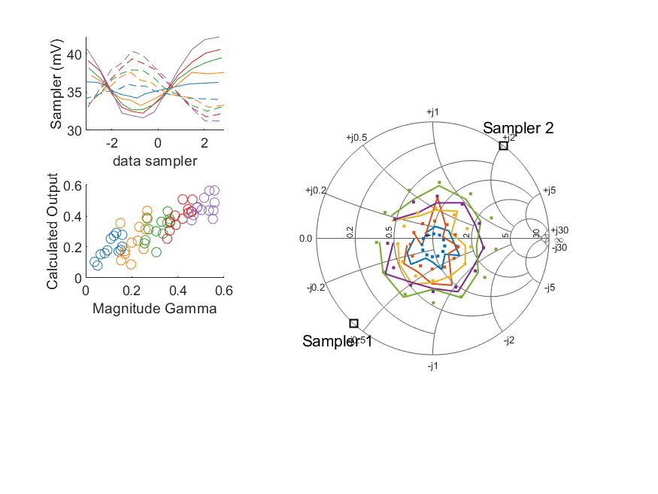
Coupled Line Performance At 10.90 GHz, 12.000000 dBm Output Power 1.25 V mean sampler bias
Sampler Av
Sampler 1: 73.032
Sampler 2: 73.032
Sampler Offset (rather than -1)
-6.0202490571713012
Goodness Of fit
0.15450315353458255
Sampler 1 Range
0.0106039915
Sampler 2 Range
0.0091782476999999994
DUT output dBm Mean
11.969014041402515
DUT input dBm Mean
12.486833688090208
RMS Error
0.08309315387349743

Slide 34
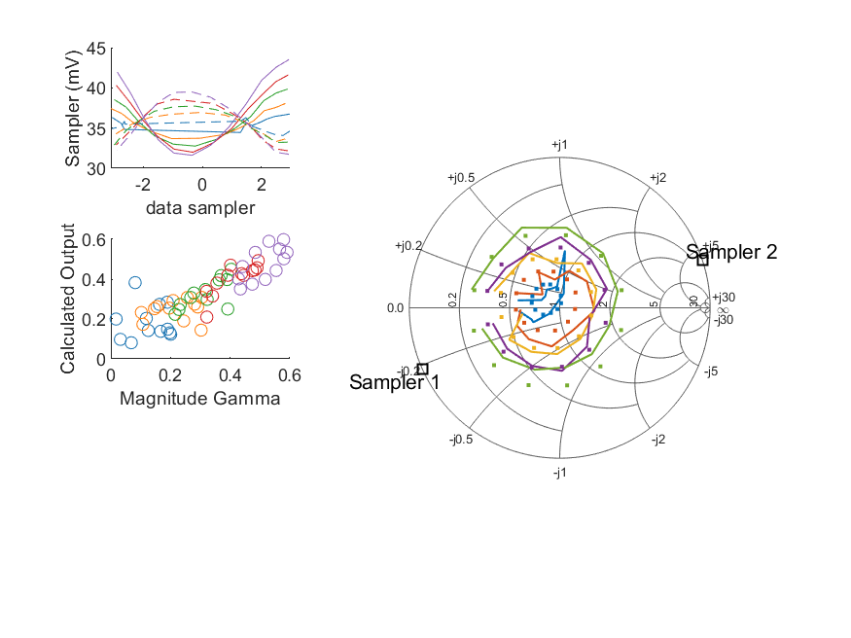
Coupled Line Performance At 11.00 GHz, 12.000000 dBm Output Power 1.25 V mean sampler bias
Sampler Av
Sampler 1: 81.090
Sampler 2: 81.090
Sampler Offset (rather than -1)
-6.165032514408443
Goodness Of fit
0.12478851598517622
Sampler 1 Range
0.011907188299999996
Sampler 2 Range
0.0077487691999999983
DUT output dBm Mean
11.992998894402925
DUT input dBm Mean
12.428040351729027
RMS Error
0.078944446942621066

Slide 35
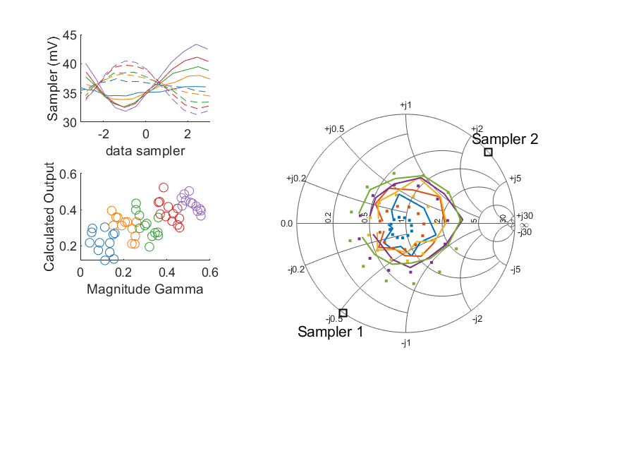
Coupled Line Performance At 11.10 GHz, 12.000000 dBm Output Power 1.25 V mean sampler bias
Sampler Av
Sampler 1: 69.750
Sampler 2: 69.750
Sampler Offset (rather than -1)
-5.3900121867078949
Goodness Of fit
0.31601764894604467
Sampler 1 Range
0.011482643899999999
Sampler 2 Range
0.0091563532000000017
DUT output dBm Mean
12.017527838693509
DUT input dBm Mean
12.502356837680573
RMS Error
0.11463449360162073

Slide 36
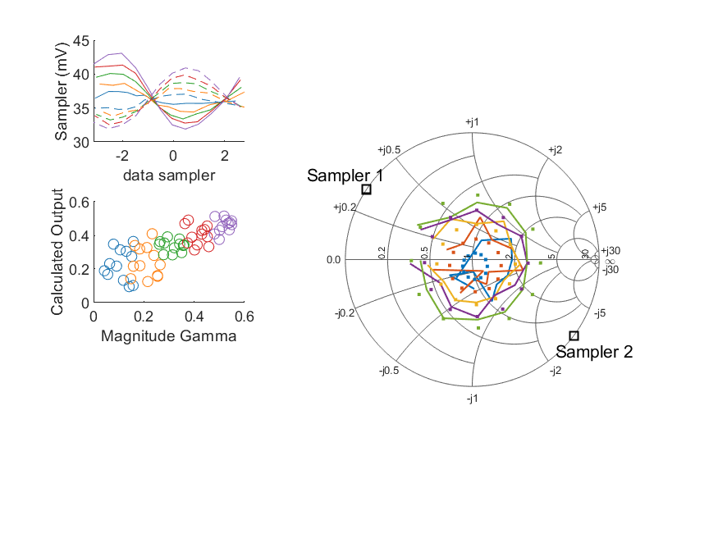
Coupled Line Performance At 11.20 GHz, 12.000000 dBm Output Power 1.25 V mean sampler bias
Sampler Av
Sampler 1: 92.038
Sampler 2: 92.038
Sampler Offset (rather than -1)
-7.4922282829082674
Goodness Of fit
0.19503576428045752
Sampler 1 Range
0.0111880559
Sampler 2 Range
0.008962076200000002
DUT output dBm Mean
11.994101038936408
DUT input dBm Mean
12.505068598832226
RMS Error
0.10578381105453531

Slide 37
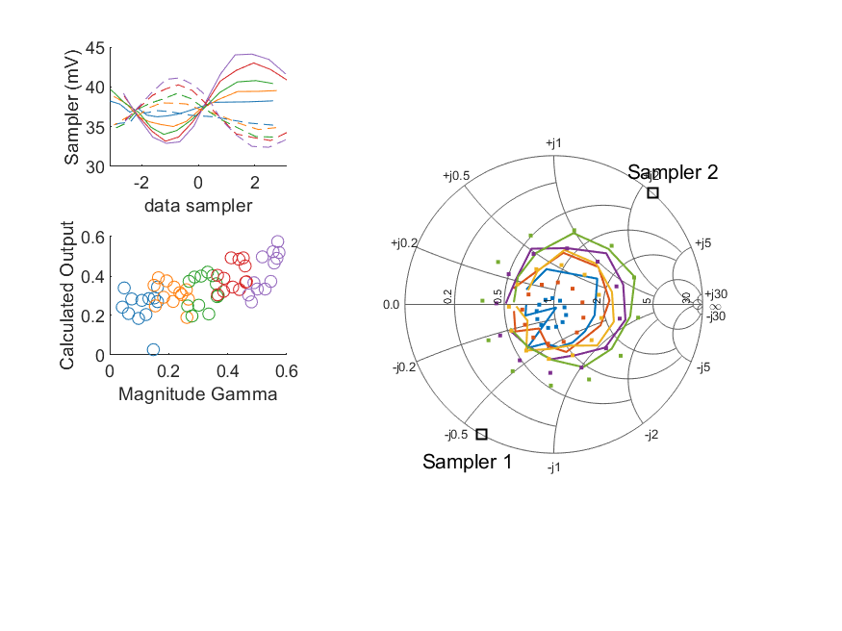
Coupled Line Performance At 11.30 GHz, 12.000000 dBm Output Power 1.25 V mean sampler bias
Sampler Av
Sampler 1: 50.084
Sampler 2: 50.084
Sampler Offset (rather than -1)
-4.5628778070473404
Goodness Of fit
0.31156816813443433
Sampler 1 Range
0.011225161599999998
Sampler 2 Range
0.0087220051000000062
DUT output dBm Mean
12.004443240766403
DUT input dBm Mean
12.503734083491009
RMS Error
0.11955671081305091

Slide 38
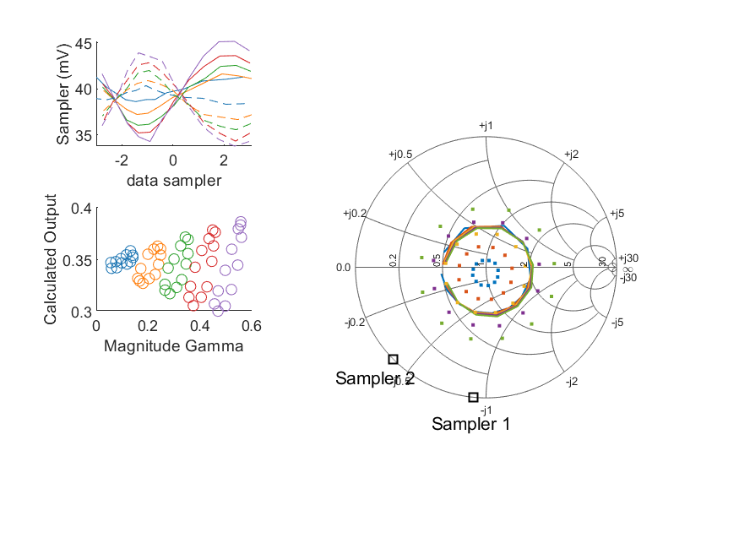
Coupled Line Performance At 11.40 GHz, 12.000000 dBm Output Power 1.25 V mean sampler bias
Sampler Av
Sampler 1: 0.000
Sampler 2: 0.000
Sampler Offset (rather than -1)
-0.10663259836458579
Goodness Of fit
0.53451048416633884
Sampler 1 Range
0.010881632800000006
Sampler 2 Range
0.010130398300000003
DUT output dBm Mean
11.992064560075432
DUT input dBm Mean
12.492317363906171
RMS Error
0.15323503607090036

Slide 39
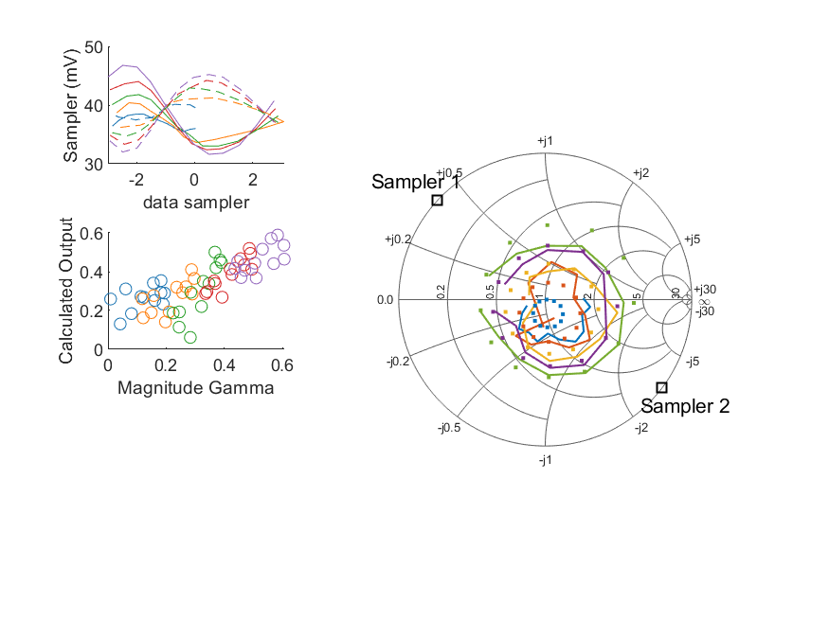
Coupled Line Performance At 10.50 GHz, 14.000000 dBm Output Power 1.25 V mean sampler bias
Sampler Av
Sampler 1: 59.970
Sampler 2: 59.970
Sampler Offset (rather than -1)
-4.9656558573613632
Goodness Of fit
0.19527487673998892
Sampler 1 Range
0.015155860699999996
Sampler 2 Range
0.0131941582
DUT output dBm Mean
13.931799315533082
DUT input dBm Mean
14.31060671658015
RMS Error
0.10715660274099045

Slide 40
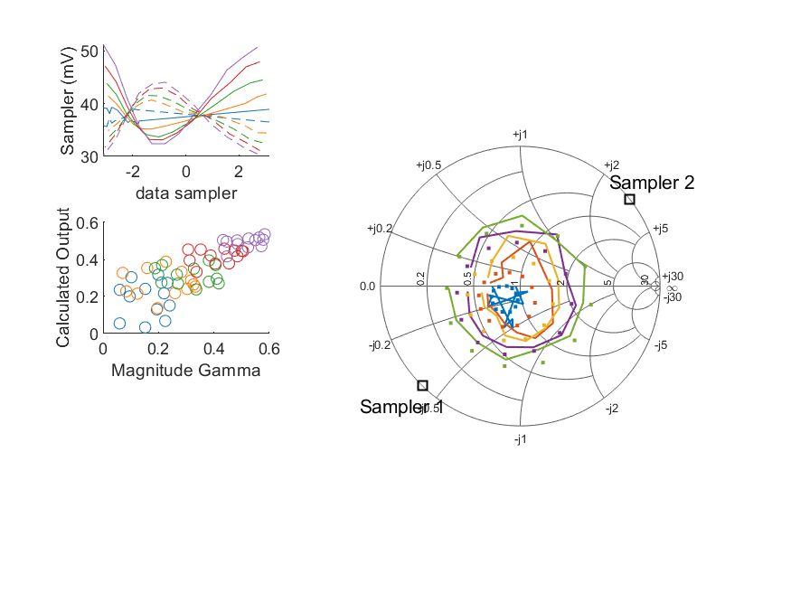
Coupled Line Performance At 10.60 GHz, 14.000000 dBm Output Power 1.25 V mean sampler bias
Sampler Av
Sampler 1: 58.737
Sampler 2: 58.737
Sampler Offset (rather than -1)
-5.1295348958708322
Goodness Of fit
0.18062948535821657
Sampler 1 Range
0.0188729724
Sampler 2 Range
0.0139264305
DUT output dBm Mean
13.916250781540374
DUT input dBm Mean
14.471695737583095
RMS Error
0.10215953341804003

Slide 41
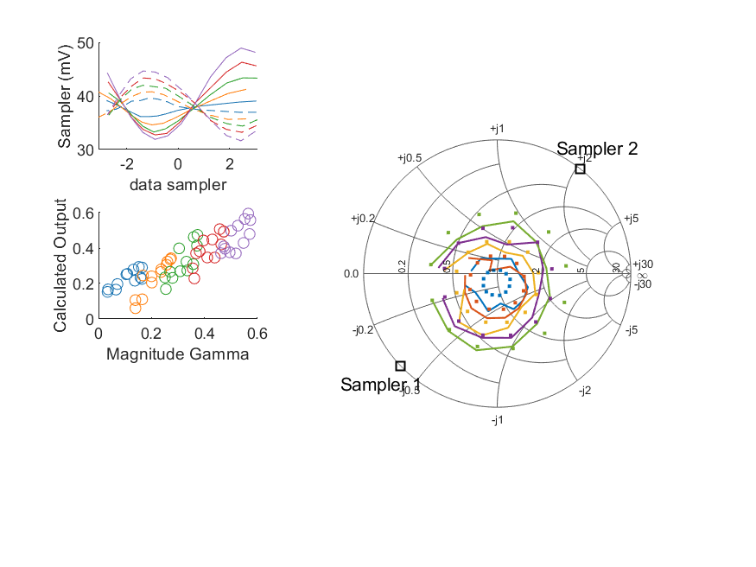
Coupled Line Performance At 10.70 GHz, 14.000000 dBm Output Power 1.25 V mean sampler bias
Sampler Av
Sampler 1: 52.652
Sampler 2: 52.652
Sampler Offset (rather than -1)
-4.8092187818460781
Goodness Of fit
0.14314765264050289
Sampler 1 Range
0.017037334299999998
Sampler 2 Range
0.013024919400000001
DUT output dBm Mean
13.948978601157418
DUT input dBm Mean
14.371430244257152
RMS Error
0.081265721579575914

Slide 42
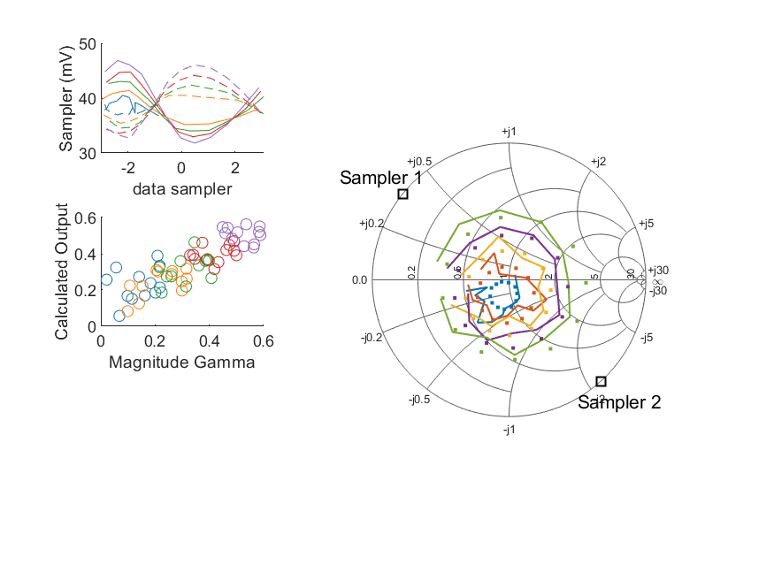
Coupled Line Performance At 10.80 GHz, 14.000000 dBm Output Power 1.25 V mean sampler bias
Sampler Av
Sampler 1: 73.040
Sampler 2: 73.040
Sampler Offset (rather than -1)
-5.6710983749507626
Goodness Of fit
0.18178389671464301
Sampler 1 Range
0.015074823399999999
Sampler 2 Range
0.013384951000000006
DUT output dBm Mean
13.935490482146317
DUT input dBm Mean
14.380258629942778
RMS Error
0.088172212935887936

Slide 43
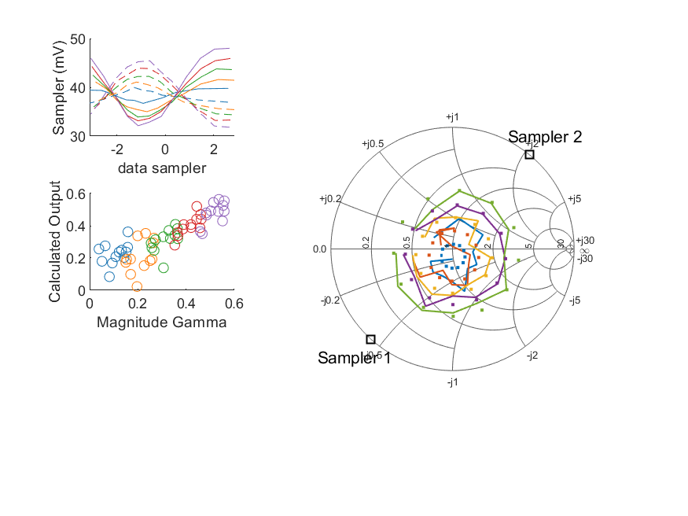
Coupled Line Performance At 10.90 GHz, 14.000000 dBm Output Power 1.25 V mean sampler bias
Sampler Av
Sampler 1: 63.330
Sampler 2: 63.330
Sampler Offset (rather than -1)
-5.5787199607588462
Goodness Of fit
0.11498208309768983
Sampler 1 Range
0.015875308500000004
Sampler 2 Range
0.0136401939
DUT output dBm Mean
13.92341220806918
DUT input dBm Mean
14.440601854756876
RMS Error
0.091163132060520582

Slide 44
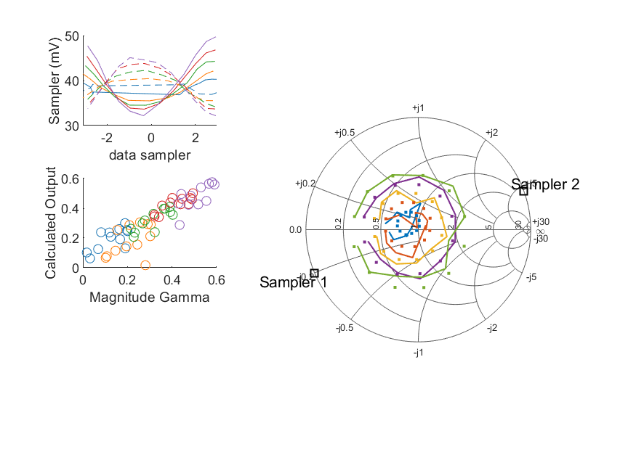
Coupled Line Performance At 11.00 GHz, 14.000000 dBm Output Power 1.25 V mean sampler bias
Sampler Av
Sampler 1: 62.619
Sampler 2: 62.619
Sampler Offset (rather than -1)
-4.9818651813555768
Goodness Of fit
0.080424028887568708
Sampler 1 Range
0.017542516399999999
Sampler 2 Range
0.012923306100000004
DUT output dBm Mean
13.950980761069593
DUT input dBm Mean
14.385472351729023
RMS Error
0.070907702686181809

Slide 45
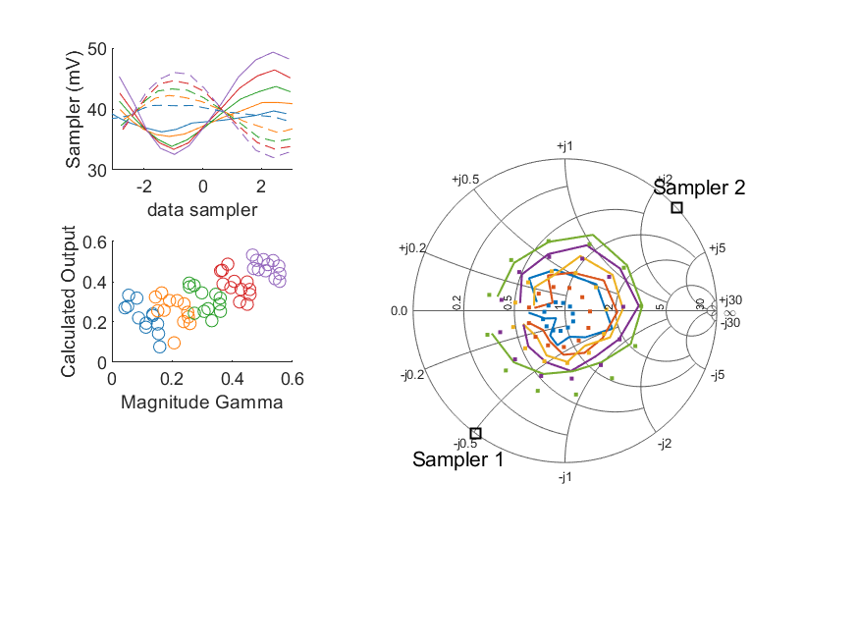
Coupled Line Performance At 11.10 GHz, 14.000000 dBm Output Power 1.25 V mean sampler bias
Sampler Av
Sampler 1: 56.518
Sampler 2: 56.518
Sampler Offset (rather than -1)
-4.6637262770238905
Goodness Of fit
0.22707818919739525
Sampler 1 Range
0.016800202899999998
Sampler 2 Range
0.013965133599999999
DUT output dBm Mean
13.971304322026844
DUT input dBm Mean
14.456050671013907
RMS Error
0.10598637997865062

Slide 46
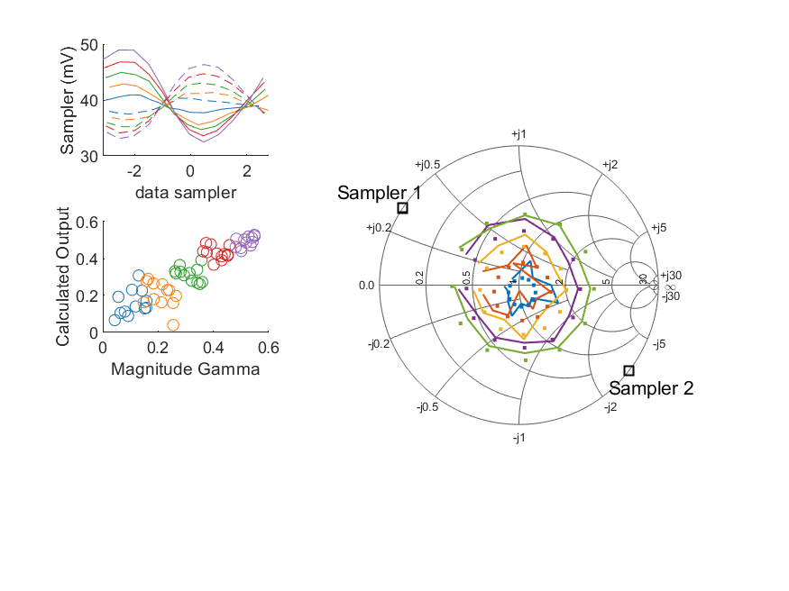
Coupled Line Performance At 11.20 GHz, 14.000000 dBm Output Power 1.25 V mean sampler bias
Sampler Av
Sampler 1: 71.201
Sampler 2: 71.201
Sampler Offset (rather than -1)
-6.2881818297740049
Goodness Of fit
0.086474635317005416
Sampler 1 Range
0.016489588700000002
Sampler 2 Range
0.013261095100000002
DUT output dBm Mean
13.944304438936406
DUT input dBm Mean
14.454856765498896
RMS Error
0.075379868302611369

Slide 47
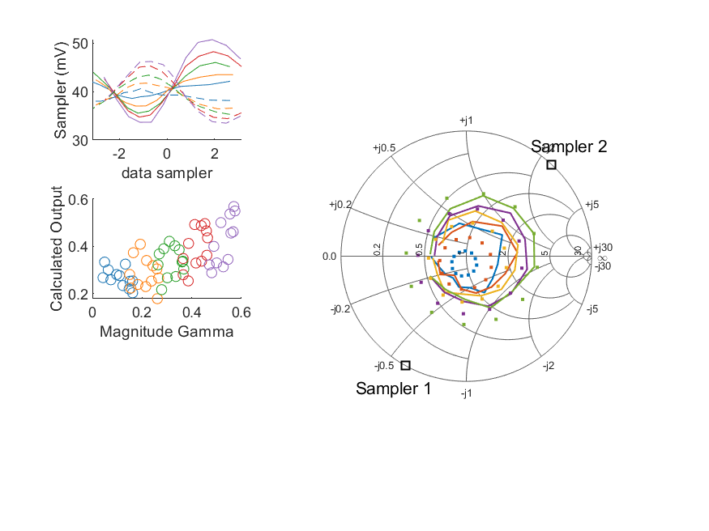
Coupled Line Performance At 11.30 GHz, 14.000000 dBm Output Power 1.25 V mean sampler bias
Sampler Av
Sampler 1: 33.819
Sampler 2: 33.819
Sampler Offset (rather than -1)
-3.2699301642132985
Goodness Of fit
0.30503187548655786
Sampler 1 Range
0.0170844629
Sampler 2 Range
0.012748387100000001
DUT output dBm Mean
13.96108230743307
DUT input dBm Mean
14.459667250157677
RMS Error
0.11753500074726465

Slide 48
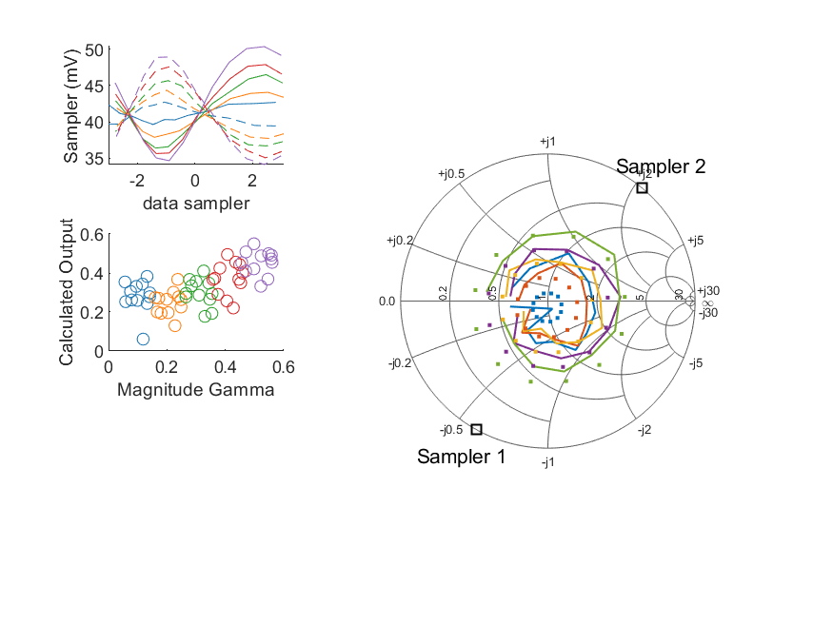
Coupled Line Performance At 11.40 GHz, 14.000000 dBm Output Power 1.25 V mean sampler bias
Sampler Av
Sampler 1: 58.228
Sampler 2: 58.228
Sampler Offset (rather than -1)
-4.9971537545604958
Goodness Of fit
0.26877100110770802
Sampler 1 Range
0.015750750899999999
Sampler 2 Range
0.014851251199999999
DUT output dBm Mean
13.949671293408766
DUT input dBm Mean
14.449901530572836
RMS Error
0.11810384980440429

Slide 49
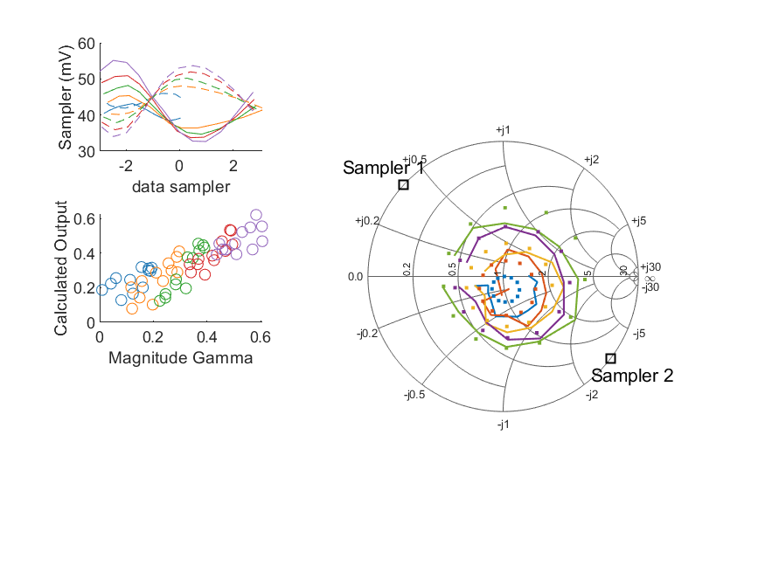
Coupled Line Performance At 10.50 GHz, 16.000000 dBm Output Power 1.25 V mean sampler bias
Sampler Av
Sampler 1: 45.373
Sampler 2: 45.373
Sampler Offset (rather than -1)
-4.1536459892009425
Goodness Of fit
0.15786157714768628
Sampler 1 Range
0.022457569999999996
Sampler 2 Range
0.019641283099999997
DUT output dBm Mean
15.89143031553308
DUT input dBm Mean
16.273465216580146
RMS Error
0.092940963284642381

Slide 50
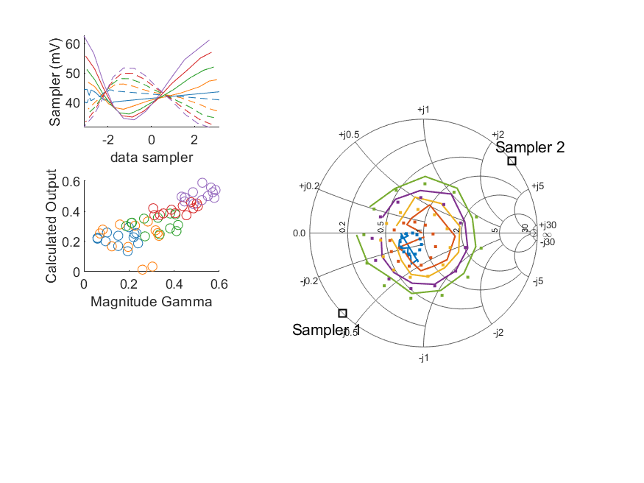
Coupled Line Performance At 10.60 GHz, 16.000000 dBm Output Power 1.25 V mean sampler bias
Sampler Av
Sampler 1: 44.541
Sampler 2: 44.541
Sampler Offset (rather than -1)
-4.3017875092075899
Goodness Of fit
0.14212213225371223
Sampler 1 Range
0.028633641600000002
Sampler 2 Range
0.020333512999999998
DUT output dBm Mean
15.884810398207039
DUT input dBm Mean
16.442108404249762
RMS Error
0.096093219043301509

Slide 51
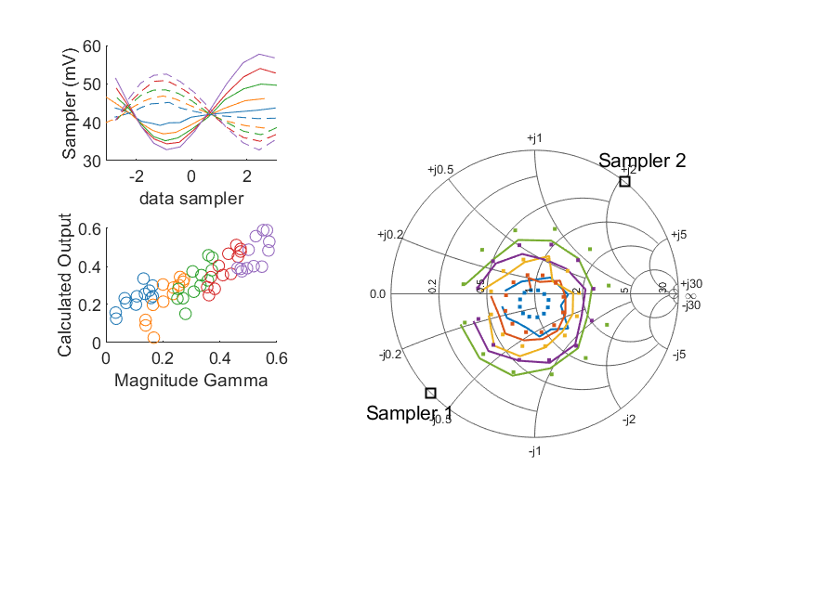
Coupled Line Performance At 10.70 GHz, 16.000000 dBm Output Power 1.25 V mean sampler bias
Sampler Av
Sampler 1: 37.964
Sampler 2: 37.964
Sampler Offset (rather than -1)
-3.7729332174234735
Goodness Of fit
0.14820689314451929
Sampler 1 Range
0.0249005188
Sampler 2 Range
0.019783757999999999
DUT output dBm Mean
15.916556651157418
DUT input dBm Mean
16.340395410923819
RMS Error
0.083458826445660189

Slide 52
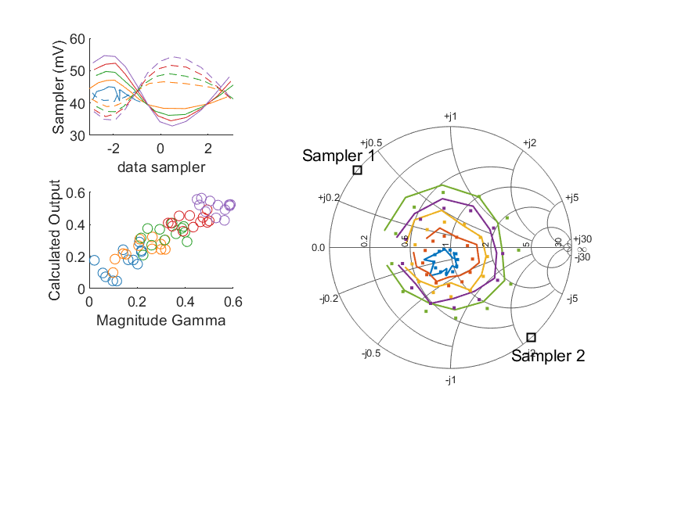
Coupled Line Performance At 10.80 GHz, 16.000000 dBm Output Power 1.25 V mean sampler bias
Sampler Av
Sampler 1: 54.712
Sampler 2: 54.712
Sampler Offset (rather than -1)
-4.7290612234878644
Goodness Of fit
0.13815183103225276
Sampler 1 Range
0.021763994199999998
Sampler 2 Range
0.0196195012
DUT output dBm Mean
15.894892798812984
DUT input dBm Mean
16.341683963276111
RMS Error
0.067011837330557378

Slide 53
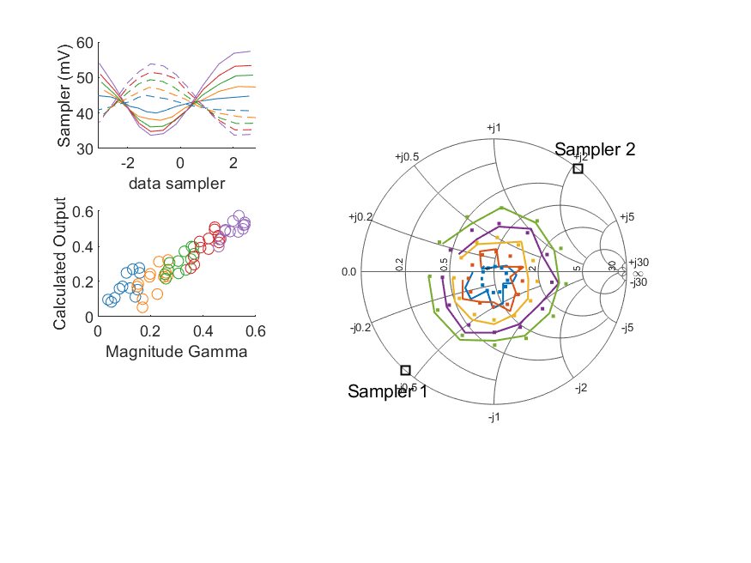
Coupled Line Performance At 10.90 GHz, 16.000000 dBm Output Power 1.25 V mean sampler bias
Sampler Av
Sampler 1: 46.630
Sampler 2: 46.630
Sampler Offset (rather than -1)
-4.5202169113830299
Goodness Of fit
0.054377541956633482
Sampler 1 Range
0.023673705000000003
Sampler 2 Range
0.020111986999999998
DUT output dBm Mean
15.889414091402513
DUT input dBm Mean
16.407471021423543
RMS Error
0.056185981970510605

Slide 54

Coupled Line Performance At 11.00 GHz, 16.000000 dBm Output Power 1.25 V mean sampler bias
Sampler Av
Sampler 1: 50.309
Sampler 2: 50.309
Sampler Offset (rather than -1)
-4.5645228832857532
Goodness Of fit
0.062965899966235583
Sampler 1 Range
0.025471547800000001
Sampler 2 Range
0.018684081799999995
DUT output dBm Mean
15.911922727736261
DUT input dBm Mean
16.348084185062355
RMS Error
0.057034864244263635

Slide 55

Coupled Line Performance At 11.10 GHz, 16.000000 dBm Output Power 1.25 V mean sampler bias
Sampler Av
Sampler 1: 43.685
Sampler 2: 43.685
Sampler Offset (rather than -1)
-3.9870060909599316
Goodness Of fit
0.20904355552686626
Sampler 1 Range
0.024319715999999998
Sampler 2 Range
0.021425710100000002
DUT output dBm Mean
15.942208955360179
DUT input dBm Mean
16.428252337680572
RMS Error
0.097027540316488414

Slide 56

Coupled Line Performance At 11.20 GHz, 16.000000 dBm Output Power 1.25 V mean sampler bias
Sampler Av
Sampler 1: 48.799
Sampler 2: 48.799
Sampler Offset (rather than -1)
-4.7618851836307234
Goodness Of fit
0.059935279720003939
Sampler 1 Range
0.0244802046
Sampler 2 Range
0.019892242099999999
DUT output dBm Mean
15.904233455603073
DUT input dBm Mean
16.416128432165561
RMS Error
0.075175623471153488

Slide 57

Coupled Line Performance At 11.30 GHz, 16.000000 dBm Output Power 1.25 V mean sampler bias
Sampler Av
Sampler 1: 13.052
Sampler 2: 13.052
Sampler Offset (rather than -1)
-1.3954974479677593
Goodness Of fit
0.46583248677783445
Sampler 1 Range
0.025819368500000002
Sampler 2 Range
0.019471745799999995
DUT output dBm Mean
15.935904840766405
DUT input dBm Mean
16.435111916824344
RMS Error
0.13938119487993009

Slide 58

Coupled Line Performance At 11.40 GHz, 16.000000 dBm Output Power 1.25 V mean sampler bias
Sampler Av
Sampler 1: 47.498
Sampler 2: 47.498
Sampler Offset (rather than -1)
-4.4067534097764165
Goodness Of fit
0.16709135899761335
Sampler 1 Range
0.022999368499999999
Sampler 2 Range
0.022596572199999998
DUT output dBm Mean
15.908042460075432
DUT input dBm Mean
16.409005530572834
RMS Error
0.084291702899823101

Slide 59

Coupled Line Performance At 10.50 GHz, 8.000000 dBm Output Power 1.50 V mean sampler bias
Sampler Av
Sampler 1: 110.420
Sampler 2: 110.420
Sampler Offset (rather than -1)
-29.874108462253194
Goodness Of fit
0.21384869388654951
Sampler 1 Range
0.0073970910000000223
Sampler 2 Range
0.0072560130000000056
DUT output dBm Mean
7.9812333655330825
DUT input dBm Mean
8.3557300499134826
RMS Error
0.11592776567389101

Slide 60

Coupled Line Performance At 10.60 GHz, 8.000000 dBm Output Power 1.50 V mean sampler bias
Sampler Av
Sampler 1: 115.129
Sampler 2: 115.129
Sampler Offset (rather than -1)
-33.641893630228552
Goodness Of fit
0.23152916620222297
Sampler 1 Range
0.0094606600000000096
Sampler 2 Range
0.0074941700000000222
DUT output dBm Mean
7.9692931482070382
DUT input dBm Mean
8.521566570916427
RMS Error
0.10832774603787465

Slide 61

Coupled Line Performance At 10.70 GHz, 8.000000 dBm Output Power 1.50 V mean sampler bias
Sampler Av
Sampler 1: 97.180
Sampler 2: 97.180
Sampler Offset (rather than -1)
-29.088967074531894
Goodness Of fit
0.12907596069831151
Sampler 1 Range
0.0082072529999999977
Sampler 2 Range
0.007310815000000026
DUT output dBm Mean
8.0038314678240834
DUT input dBm Mean
8.4250674109238215
RMS Error
0.080657606556564732

Slide 62

Coupled Line Performance At 10.80 GHz, 8.000000 dBm Output Power 1.50 V mean sampler bias
Sampler Av
Sampler 1: 137.315
Sampler 2: 137.315
Sampler Offset (rather than -1)
-35.051537892009684
Goodness Of fit
0.23684545315730524
Sampler 1 Range
0.0073352750000000022
Sampler 2 Range
0.0071764889999999804
DUT output dBm Mean
7.985825798812983
DUT input dBm Mean
8.4292806299427792
RMS Error
0.089124803578059353

Slide 63

Coupled Line Performance At 10.90 GHz, 8.000000 dBm Output Power 1.50 V mean sampler bias
Sampler Av
Sampler 1: 122.714
Sampler 2: 122.714
Sampler Offset (rather than -1)
-35.812914468322518
Goodness Of fit
0.11073835452281561
Sampler 1 Range
0.0078094949999999996
Sampler 2 Range
0.0072939159999999836
DUT output dBm Mean
7.9885055747358473
DUT input dBm Mean
8.5024798547568761
RMS Error
0.088312033646713708

Slide 64

Coupled Line Performance At 11.00 GHz, 8.000000 dBm Output Power 1.50 V mean sampler bias
Sampler Av
Sampler 1: 119.588
Sampler 2: 119.588
Sampler Offset (rather than -1)
-31.396644448042977
Goodness Of fit
0.13897567158485769
Sampler 1 Range
0.0085092740000000111
Sampler 2 Range
0.0066572779999999887
DUT output dBm Mean
8.0010092777362605
DUT input dBm Mean
8.4345316850623568
RMS Error
0.078871104043139698

Slide 65

Coupled Line Performance At 11.10 GHz, 8.000000 dBm Output Power 1.50 V mean sampler bias
Sampler Av
Sampler 1: 103.715
Sampler 2: 103.715
Sampler Offset (rather than -1)
-28.473040334628081
Goodness Of fit
0.15703510086764871
Sampler 1 Range
0.0081886340000000002
Sampler 2 Range
0.0076103019999999855
DUT output dBm Mean
8.0240640220268453
DUT input dBm Mean
8.5068956710139041
RMS Error
0.089768675654587099

Slide 66

Coupled Line Performance At 11.20 GHz, 8.000000 dBm Output Power 1.50 V mean sampler bias
Sampler Av
Sampler 1: 139.023
Sampler 2: 139.023
Sampler Offset (rather than -1)
-40.093826240674588
Goodness Of fit
0.13773267899988212
Sampler 1 Range
0.0082758510000000007
Sampler 2 Range
0.0071816849999999932
DUT output dBm Mean
8.0028451556030742
DUT input dBm Mean
8.5142689321655602
RMS Error
0.099495271428854282

Slide 67

Coupled Line Performance At 11.30 GHz, 8.000000 dBm Output Power 1.50 V mean sampler bias
Sampler Av
Sampler 1: 64.094
Sampler 2: 64.094
Sampler Offset (rather than -1)
-20.169785232012977
Goodness Of fit
0.33623268588688116
Sampler 1 Range
0.0084342089999999981
Sampler 2 Range
0.0071582929999999823
DUT output dBm Mean
8.020248490766404
DUT input dBm Mean
8.5177002501576791
RMS Error
0.12279647991587023

Slide 68

Coupled Line Performance At 11.40 GHz, 8.000000 dBm Output Power 1.50 V mean sampler bias
Sampler Av
Sampler 1: 0.000
Sampler 2: 0.000
Sampler Offset (rather than -1)
-0.59973081269447304
Goodness Of fit
0.54005709112148903
Sampler 1 Range
0.0078311959999999847
Sampler 2 Range
0.0079742309999999983
DUT output dBm Mean
7.9960461267420992
DUT input dBm Mean
8.4960380305728371
RMS Error
0.15348004297672033

Slide 69

Coupled Line Performance At 10.50 GHz, 10.000000 dBm Output Power 1.50 V mean sampler bias
Sampler Av
Sampler 1: 102.161
Sampler 2: 102.161
Sampler Offset (rather than -1)
-28.328048043709007
Goodness Of fit
0.16077335765061349
Sampler 1 Range
0.011160491999999994
Sampler 2 Range
0.010930565000000003
DUT output dBm Mean
9.9741801988664154
DUT input dBm Mean
10.350952883246814
RMS Error
0.094397809774694294

Slide 70

Coupled Line Performance At 10.60 GHz, 10.000000 dBm Output Power 1.50 V mean sampler bias
Sampler Av
Sampler 1: 96.181
Sampler 2: 96.181
Sampler Offset (rather than -1)
-28.267939302438982
Goodness Of fit
0.17872408705728562
Sampler 1 Range
0.014103694999999999
Sampler 2 Range
0.011405367999999999
DUT output dBm Mean
9.9697424815403721
DUT input dBm Mean
10.523824737583093
RMS Error
0.099379981087121649

Slide 71

Coupled Line Performance At 10.70 GHz, 10.000000 dBm Output Power 1.50 V mean sampler bias
Sampler Av
Sampler 1: 79.658
Sampler 2: 79.658
Sampler Offset (rather than -1)
-24.099049039755823
Goodness Of fit
0.14339793726726766
Sampler 1 Range
0.012430353999999977
Sampler 2 Range
0.010892177000000003
DUT output dBm Mean
10.007310467824084
DUT input dBm Mean
10.429197410923821
RMS Error
0.082317682951757884

Slide 72

Coupled Line Performance At 10.80 GHz, 10.000000 dBm Output Power 1.50 V mean sampler bias
Sampler Av
Sampler 1: 105.088
Sampler 2: 105.088
Sampler Offset (rather than -1)
-27.588009899009009
Goodness Of fit
0.19143740540870605
Sampler 1 Range
0.010785094999999995
Sampler 2 Range
0.010796500999999986
DUT output dBm Mean
9.9834382988129846
DUT input dBm Mean
10.427166963276113
RMS Error
0.084925662407453972

Slide 73

Coupled Line Performance At 10.90 GHz, 10.000000 dBm Output Power 1.50 V mean sampler bias
Sampler Av
Sampler 1: 95.816
Sampler 2: 95.816
Sampler Offset (rather than -1)
-28.508052772407815
Goodness Of fit
0.061605021756450218
Sampler 1 Range
0.011928509000000004
Sampler 2 Range
0.010734596000000013
DUT output dBm Mean
9.9855102414025136
DUT input dBm Mean
10.500243021423541
RMS Error
0.063922737242430125

Slide 74

Coupled Line Performance At 11.00 GHz, 10.000000 dBm Output Power 1.50 V mean sampler bias
Sampler Av
Sampler 1: 98.995
Sampler 2: 98.995
Sampler Offset (rather than -1)
-26.856107667563951
Goodness Of fit
0.064624118925776131
Sampler 1 Range
0.012790217999999992
Sampler 2 Range
0.01051460899999998
DUT output dBm Mean
10.004714111069593
DUT input dBm Mean
10.438169518395689
RMS Error
0.061854242463037307

Slide 75

Coupled Line Performance At 11.10 GHz, 10.000000 dBm Output Power 1.50 V mean sampler bias
Sampler Av
Sampler 1: 92.111
Sampler 2: 92.111
Sampler Offset (rather than -1)
-25.588006605146948
Goodness Of fit
0.20829646957105219
Sampler 1 Range
0.012143113000000011
Sampler 2 Range
0.011563735000000019
DUT output dBm Mean
10.026679688693513
DUT input dBm Mean
10.510261004347237
RMS Error
0.093849151409886464

Slide 76

Coupled Line Performance At 11.20 GHz, 10.000000 dBm Output Power 1.50 V mean sampler bias
Sampler Av
Sampler 1: 108.070
Sampler 2: 108.070
Sampler Offset (rather than -1)
-31.833209601388777
Goodness Of fit
0.098974618502008657
Sampler 1 Range
0.012595155999999996
Sampler 2 Range
0.01050669500000001
DUT output dBm Mean
9.994427322269738
DUT input dBm Mean
10.504426765498893
RMS Error
0.089942039917591615

Slide 77

Coupled Line Performance At 11.30 GHz, 10.000000 dBm Output Power 1.50 V mean sampler bias
Sampler Av
Sampler 1: 47.849
Sampler 2: 47.849
Sampler Offset (rather than -1)
-15.386639509883347
Goodness Of fit
0.28996251278372265
Sampler 1 Range
0.012966223999999998
Sampler 2 Range
0.010764228000000015
DUT output dBm Mean
10.012228990766404
DUT input dBm Mean
10.50920358349101
RMS Error
0.11478505096262447

Slide 78

Coupled Line Performance At 11.40 GHz, 10.000000 dBm Output Power 1.50 V mean sampler bias
Sampler Av
Sampler 1: 86.776
Sampler 2: 86.776
Sampler Offset (rather than -1)
-23.640405238715648
Goodness Of fit
0.27940711170789884
Sampler 1 Range
0.011596018999999985
Sampler 2 Range
0.012488795999999996
DUT output dBm Mean
10.001372293408766
DUT input dBm Mean
10.500631030572837
RMS Error
0.11392040077224921

Slide 79

Coupled Line Performance At 10.50 GHz, 12.000000 dBm Output Power 1.50 V mean sampler bias
Sampler Av
Sampler 1: 64.470
Sampler 2: 64.470
Sampler Offset (rather than -1)
-18.648116679334894
Goodness Of fit
0.17822415173155948
Sampler 1 Range
0.016885579000000012
Sampler 2 Range
0.015688879999999988
DUT output dBm Mean
11.962074148866416
DUT input dBm Mean
12.340633383246816
RMS Error
0.094655254605905306

Slide 80

Coupled Line Performance At 10.60 GHz, 12.000000 dBm Output Power 1.50 V mean sampler bias
Sampler Av
Sampler 1: 66.213
Sampler 2: 66.213
Sampler Offset (rather than -1)
-19.94324321368196
Goodness Of fit
0.14073782567334303
Sampler 1 Range
0.020874276999999997
Sampler 2 Range
0.016521178999999997
DUT output dBm Mean
11.946023048207037
DUT input dBm Mean
12.500793737583091
RMS Error
0.086364308948957025

Slide 81

Coupled Line Performance At 10.70 GHz, 12.000000 dBm Output Power 1.50 V mean sampler bias
Sampler Av
Sampler 1: 55.551
Sampler 2: 55.551
Sampler Offset (rather than -1)
-17.355189506912275
Goodness Of fit
0.14579335783044997
Sampler 1 Range
0.018450012999999987
Sampler 2 Range
0.015665194999999993
DUT output dBm Mean
11.987401901157417
DUT input dBm Mean
12.410640744257156
RMS Error
0.079949171129314753

Slide 82

Coupled Line Performance At 10.80 GHz, 12.000000 dBm Output Power 1.50 V mean sampler bias
Sampler Av
Sampler 1: 80.354
Sampler 2: 80.354
Sampler Offset (rather than -1)
-21.813676804441208
Goodness Of fit
0.16486277776247893
Sampler 1 Range
0.01600753399999999
Sampler 2 Range
0.015651976999999984
DUT output dBm Mean
11.965066332146314
DUT input dBm Mean
12.410148463276112
RMS Error
0.074721877990347199

Slide 83

Coupled Line Performance At 10.90 GHz, 12.000000 dBm Output Power 1.50 V mean sampler bias
Sampler Av
Sampler 1: 68.733
Sampler 2: 68.733
Sampler Offset (rather than -1)
-20.764033488139241
Goodness Of fit
0.069844008270929431
Sampler 1 Range
0.017508558000000007
Sampler 2 Range
0.015968595000000002
DUT output dBm Mean
11.956894758069181
DUT input dBm Mean
12.473272354756878
RMS Error
0.062120469488863267

Slide 84

Coupled Line Performance At 11.00 GHz, 12.000000 dBm Output Power 1.50 V mean sampler bias
Sampler Av
Sampler 1: 69.736
Sampler 2: 69.736
Sampler Offset (rather than -1)
-19.723594685125626
Goodness Of fit
0.072090793800809835
Sampler 1 Range
0.018746940000000017
Sampler 2 Range
0.015228747999999986
DUT output dBm Mean
11.980638194402927
DUT input dBm Mean
12.416053185062356
RMS Error
0.068832460874359305

Slide 85

Coupled Line Performance At 11.10 GHz, 12.000000 dBm Output Power 1.50 V mean sampler bias
Sampler Av
Sampler 1: 60.221
Sampler 2: 60.221
Sampler Offset (rather than -1)
-17.111571277888288
Goodness Of fit
0.21608238433136281
Sampler 1 Range
0.017904447999999989
Sampler 2 Range
0.017097200000000007
DUT output dBm Mean
12.003408738693512
DUT input dBm Mean
12.486450004347239
RMS Error
0.099183018045420193

Slide 86

Coupled Line Performance At 11.20 GHz, 12.000000 dBm Output Power 1.50 V mean sampler bias
Sampler Av
Sampler 1: 77.472
Sampler 2: 77.472
Sampler Offset (rather than -1)
-23.414683979164575
Goodness Of fit
0.076828466694806252
Sampler 1 Range
0.018226338000000009
Sampler 2 Range
0.015800557999999992
DUT output dBm Mean
11.976710622269742
DUT input dBm Mean
12.488137098832226
RMS Error
0.064060960249441939

Slide 87

Coupled Line Performance At 11.30 GHz, 12.000000 dBm Output Power 1.50 V mean sampler bias
Sampler Av
Sampler 1: 31.065
Sampler 2: 31.065
Sampler Offset (rather than -1)
-10.229565046748773
Goodness Of fit
0.33300106644960448
Sampler 1 Range
0.019137532000000013
Sampler 2 Range
0.015658366000000007
DUT output dBm Mean
11.991057524099737
DUT input dBm Mean
12.489418250157678
RMS Error
0.12459726291235401

Slide 88

Coupled Line Performance At 11.40 GHz, 12.000000 dBm Output Power 1.50 V mean sampler bias
Sampler Av
Sampler 1: 67.150
Sampler 2: 67.150
Sampler Offset (rather than -1)
-18.849878690573622
Goodness Of fit
0.18451676595501654
Sampler 1 Range
0.01693072000000001
Sampler 2 Range
0.017886903999999981
DUT output dBm Mean
11.9751175267421
DUT input dBm Mean
12.475797197239501
RMS Error
0.08408474351771221

Slide 89

Coupled Line Performance At 10.50 GHz, 6.000000 dBm Output Power 1.75 V mean sampler bias
Sampler Av
Sampler 1: 219.135
Sampler 2: 219.135
Sampler Offset (rather than -1)
-116.99240326018253
Goodness Of fit
0.15361053440152858
Sampler 1 Range
0.0045692430000000006
Sampler 2 Range
0.0045769679999999591
DUT output dBm Mean
5.943749032199749
DUT input dBm Mean
6.3194050499134811
RMS Error
0.10142547655796245

Slide 90

Coupled Line Performance At 10.60 GHz, 6.000000 dBm Output Power 1.75 V mean sampler bias
Sampler Av
Sampler 1: 166.404
Sampler 2: 166.404
Sampler Offset (rather than -1)
-96.756459387664961
Goodness Of fit
0.1902096731396905
Sampler 1 Range
0.0057679620000000154
Sampler 2 Range
0.0048935099999999898
DUT output dBm Mean
5.9394119815403714
DUT input dBm Mean
6.4895480709164275
RMS Error
0.10199819344864315

Slide 91

Coupled Line Performance At 10.70 GHz, 6.000000 dBm Output Power 1.75 V mean sampler bias
Sampler Av
Sampler 1: 179.071
Sampler 2: 179.071
Sampler Offset (rather than -1)
-105.63169108839324
Goodness Of fit
0.12850250990501313
Sampler 1 Range
0.0051025740000000264
Sampler 2 Range
0.0044653789999999915
DUT output dBm Mean
5.9718098011574163
DUT input dBm Mean
6.3898105775904872
RMS Error
0.07665238749127784

Slide 92

Coupled Line Performance At 10.80 GHz, 6.000000 dBm Output Power 1.75 V mean sampler bias
Sampler Av
Sampler 1: 224.752
Sampler 2: 224.752
Sampler Offset (rather than -1)
-113.71666618219417
Goodness Of fit
0.13171314476024742
Sampler 1 Range
0.0044584999999999764
Sampler 2 Range
0.0046197060000000012
DUT output dBm Mean
5.9394734654796499
DUT input dBm Mean
6.3810132966094466
RMS Error
0.061970218329365868

Slide 93

Coupled Line Performance At 10.90 GHz, 6.000000 dBm Output Power 1.75 V mean sampler bias
Sampler Av
Sampler 1: 215.612
Sampler 2: 215.612
Sampler Offset (rather than -1)
-124.97885155502534
Goodness Of fit
0.044723616862599028
Sampler 1 Range
0.0048089250000000194
Sampler 2 Range
0.0045778960000000257
DUT output dBm Mean
5.9398610747358473
DUT input dBm Mean
6.4548931880902085
RMS Error
0.068451331261219717

Slide 94

Coupled Line Performance At 11.00 GHz, 6.000000 dBm Output Power 1.75 V mean sampler bias
Sampler Av
Sampler 1: 261.885
Sampler 2: 261.885
Sampler Offset (rather than -1)
-140.48024589202245
Goodness Of fit
0.087964337363570483
Sampler 1 Range
0.0053218429999999928
Sampler 2 Range
0.0043521770000000126
DUT output dBm Mean
5.9687441110695927
DUT input dBm Mean
6.4021433517290234
RMS Error
0.072893856612737201

Slide 95

Coupled Line Performance At 11.10 GHz, 6.000000 dBm Output Power 1.75 V mean sampler bias
Sampler Av
Sampler 1: 198.379
Sampler 2: 198.379
Sampler Offset (rather than -1)
-106.30009222756711
Goodness Of fit
0.20458066568988409
Sampler 1 Range
0.0050817620000000452
Sampler 2 Range
0.00510575000000002
DUT output dBm Mean
5.9887988553601774
DUT input dBm Mean
6.4735578376805725
RMS Error
0.10018138287963292

Slide 96

Coupled Line Performance At 11.20 GHz, 6.000000 dBm Output Power 1.75 V mean sampler bias
Sampler Av
Sampler 1: 227.382
Sampler 2: 227.382
Sampler Offset (rather than -1)
-129.09756597785142
Goodness Of fit
0.11247517273198882
Sampler 1 Range
0.005243995999999973
Sampler 2 Range
0.0043834609999999774
DUT output dBm Mean
5.9564289889364082
DUT input dBm Mean
6.4671485988322264
RMS Error
0.082235356666982146

Slide 97

Coupled Line Performance At 11.30 GHz, 6.000000 dBm Output Power 1.75 V mean sampler bias
Sampler Av
Sampler 1: 104.545
Sampler 2: 104.545
Sampler Offset (rather than -1)
-66.283106583786562
Goodness Of fit
0.32256222595755768
Sampler 1 Range
0.0052610539999999872
Sampler 2 Range
0.0044621850000000074
DUT output dBm Mean
5.9789829907664034
DUT input dBm Mean
6.4775144168243459
RMS Error
0.12144381195972949

Slide 98

Coupled Line Performance At 11.40 GHz, 6.000000 dBm Output Power 1.75 V mean sampler bias
Sampler Av
Sampler 1: 0.000
Sampler 2: 0.000
Sampler Offset (rather than -1)
-2.9405469234925827
Goodness Of fit
0.53409382090168167
Sampler 1 Range
0.0047481520000000055
Sampler 2 Range
0.0051684830000000015
DUT output dBm Mean
5.9957329600754328
DUT input dBm Mean
6.4953896972395029
RMS Error
0.15327843323290005

Slide 99

Coupled Line Performance At 10.50 GHz, 8.000000 dBm Output Power 1.75 V mean sampler bias
Sampler Av
Sampler 1: 145.238
Sampler 2: 145.238
Sampler Offset (rather than -1)
-79.380317937876185
Goodness Of fit
0.11832130125323284
Sampler 1 Range
0.0070634940000000035
Sampler 2 Range
0.007003301999999989
DUT output dBm Mean
7.9972545321997481
DUT input dBm Mean
8.3717662165801485
RMS Error
0.086519238201899121

Slide 100

Coupled Line Performance At 10.60 GHz, 8.000000 dBm Output Power 1.75 V mean sampler bias
Sampler Av
Sampler 1: 137.634
Sampler 2: 137.634
Sampler Offset (rather than -1)
-80.437869962809614
Goodness Of fit
0.14797736557348734
Sampler 1 Range
0.0091874289999999692
Sampler 2 Range
0.0072643090000000243
DUT output dBm Mean
7.983707648207039
DUT input dBm Mean
8.5374865709164265
RMS Error
0.088832439132638719

Slide 101

Coupled Line Performance At 10.70 GHz, 8.000000 dBm Output Power 1.75 V mean sampler bias
Sampler Av
Sampler 1: 128.721
Sampler 2: 128.721
Sampler Offset (rather than -1)
-76.056373311365931
Goodness Of fit
0.13006358427867676
Sampler 1 Range
0.00815243099999996
Sampler 2 Range
0.0070192129999999686
DUT output dBm Mean
8.0173561344907505
DUT input dBm Mean
8.4386184109238211
RMS Error
0.07796320748022223

Slide 102

Coupled Line Performance At 10.80 GHz, 8.000000 dBm Output Power 1.75 V mean sampler bias
Sampler Av
Sampler 1: 196.713
Sampler 2: 196.713
Sampler Offset (rather than -1)
-101.10533447102945
Goodness Of fit
0.14216099405750188
Sampler 1 Range
0.0068968469999999837
Sampler 2 Range
0.0071721879999999683
DUT output dBm Mean
8.0039032988129826
DUT input dBm Mean
8.4482041299427788
RMS Error
0.074022965543153671

Slide 103

Coupled Line Performance At 10.90 GHz, 8.000000 dBm Output Power 1.75 V mean sampler bias
Sampler Av
Sampler 1: 146.145
Sampler 2: 146.145
Sampler Offset (rather than -1)
-84.010319012555428
Goodness Of fit
0.040771220481287347
Sampler 1 Range
0.0075105919999999826
Sampler 2 Range
0.0071798909999999938
DUT output dBm Mean
7.9927144080691788
DUT input dBm Mean
8.5090730214235428
RMS Error
0.052438150868687

Slide 104

Coupled Line Performance At 11.00 GHz, 8.000000 dBm Output Power 1.75 V mean sampler bias
Sampler Av
Sampler 1: 153.653
Sampler 2: 153.653
Sampler Offset (rather than -1)
-82.771787376504335
Goodness Of fit
0.073489462474274181
Sampler 1 Range
0.0083571729999999955
Sampler 2 Range
0.0066942290000000515
DUT output dBm Mean
8.0245134444029258
DUT input dBm Mean
8.4563176850623574
RMS Error
0.069608362733431781

Slide 105

Coupled Line Performance At 11.10 GHz, 8.000000 dBm Output Power 1.75 V mean sampler bias
Sampler Av
Sampler 1: 130.513
Sampler 2: 130.513
Sampler Offset (rather than -1)
-70.1079875583725
Goodness Of fit
0.17135736703199192
Sampler 1 Range
0.007875032000000004
Sampler 2 Range
0.007667776000000015
DUT output dBm Mean
8.0455513553601783
DUT input dBm Mean
8.5292453376805728
RMS Error
0.093088310139887845

Slide 106

Coupled Line Performance At 11.20 GHz, 8.000000 dBm Output Power 1.75 V mean sampler bias
Sampler Av
Sampler 1: 177.344
Sampler 2: 177.344
Sampler Offset (rather than -1)
-102.15028900045431
Goodness Of fit
0.086693992398058306
Sampler 1 Range
0.0080703919999999818
Sampler 2 Range
0.0070638679999999732
DUT output dBm Mean
8.0150941556030748
DUT input dBm Mean
8.5261620988322271
RMS Error
0.077065022530925037

Slide 107

Coupled Line Performance At 11.30 GHz, 8.000000 dBm Output Power 1.75 V mean sampler bias
Sampler Av
Sampler 1: 72.616
Sampler 2: 72.616
Sampler Offset (rather than -1)
-45.506567741351382
Goodness Of fit
0.31158342602375622
Sampler 1 Range
0.0084399450000000042
Sampler 2 Range
0.0071463339999999764
DUT output dBm Mean
8.0385119907664038
DUT input dBm Mean
8.5371175834910122
RMS Error
0.1210767128362961

Slide 108

Coupled Line Performance At 11.40 GHz, 8.000000 dBm Output Power 1.75 V mean sampler bias
Sampler Av
Sampler 1: 149.738
Sampler 2: 149.738
Sampler Offset (rather than -1)
-78.719814299076347
Goodness Of fit
0.19617127774702475
Sampler 1 Range
0.0073742409999999481
Sampler 2 Range
0.00805529100000002
DUT output dBm Mean
8.010771293408764
DUT input dBm Mean
8.5130731972395015
RMS Error
0.092147738147778782

Slide 109

Coupled Line Performance At 10.50 GHz, 10.000000 dBm Output Power 1.75 V mean sampler bias
Sampler Av
Sampler 1: 101.768
Sampler 2: 101.768
Sampler Offset (rather than -1)
-56.538123490531774
Goodness Of fit
0.13091550568535248
Sampler 1 Range
0.010968058999999974
Sampler 2 Range
0.010730694000000041
DUT output dBm Mean
9.9810288655330819
DUT input dBm Mean
10.357504216580148
RMS Error
0.087814659253091176

Slide 110

Coupled Line Performance At 10.60 GHz, 10.000000 dBm Output Power 1.75 V mean sampler bias
Sampler Av
Sampler 1: 92.213
Sampler 2: 92.213
Sampler Offset (rather than -1)
-54.002052848717931
Goodness Of fit
0.10944636140144681
Sampler 1 Range
0.013755250999999968
Sampler 2 Range
0.011196201999999988
DUT output dBm Mean
9.9680046482070388
DUT input dBm Mean
10.522904404249761
RMS Error
0.077532802765607672

Slide 111

Coupled Line Performance At 10.70 GHz, 10.000000 dBm Output Power 1.75 V mean sampler bias
Sampler Av
Sampler 1: 87.814
Sampler 2: 87.814
Sampler Offset (rather than -1)
-52.737234887714308
Goodness Of fit
0.11114044395893515
Sampler 1 Range
0.012408986000000011
Sampler 2 Range
0.010554072000000025
DUT output dBm Mean
10.01058163449075
DUT input dBm Mean
10.432706744257155
RMS Error
0.067843171772704811

Slide 112

Coupled Line Performance At 10.80 GHz, 10.000000 dBm Output Power 1.75 V mean sampler bias
Sampler Av
Sampler 1: 117.436
Sampler 2: 117.436
Sampler Offset (rather than -1)
-61.027893789888701
Goodness Of fit
0.096008970990543618
Sampler 1 Range
0.010442765999999992
Sampler 2 Range
0.010829203999999981
DUT output dBm Mean
9.9892811321463171
DUT input dBm Mean
10.434125296609446
RMS Error
0.055621945223717925

Slide 113

Coupled Line Performance At 10.90 GHz, 10.000000 dBm Output Power 1.75 V mean sampler bias
Sampler Av
Sampler 1: 101.245
Sampler 2: 101.245
Sampler Offset (rather than -1)
-58.671063477502713
Goodness Of fit
0.03304790084651852
Sampler 1 Range
0.011522366000000006
Sampler 2 Range
0.010869391000000006
DUT output dBm Mean
9.9890529080691799
DUT input dBm Mean
10.507417188090209
RMS Error
0.044252470509503969

Slide 114

Coupled Line Performance At 11.00 GHz, 10.000000 dBm Output Power 1.75 V mean sampler bias
Sampler Av
Sampler 1: 105.989
Sampler 2: 105.989
Sampler Offset (rather than -1)
-58.006403098188812
Goodness Of fit
0.047797462319332143
Sampler 1 Range
0.012607676999999984
Sampler 2 Range
0.01024660799999999
DUT output dBm Mean
10.002107277736259
DUT input dBm Mean
10.43604501839569
RMS Error
0.06307548229001228

Slide 115

Coupled Line Performance At 11.10 GHz, 10.000000 dBm Output Power 1.75 V mean sampler bias
Sampler Av
Sampler 1: 94.701
Sampler 2: 94.701
Sampler Offset (rather than -1)
-51.554523284746296
Goodness Of fit
0.1980313592940896
Sampler 1 Range
0.01215301799999996
Sampler 2 Range
0.011641928000000024
DUT output dBm Mean
10.03628335536018
DUT input dBm Mean
10.520765671013907
RMS Error
0.097411724404564179

Slide 116

Coupled Line Performance At 11.20 GHz, 10.000000 dBm Output Power 1.75 V mean sampler bias
Sampler Av
Sampler 1: 105.697
Sampler 2: 105.697
Sampler Offset (rather than -1)
-60.896115961158451
Goodness Of fit
0.045532623506472983
Sampler 1 Range
0.0122583
Sampler 2 Range
0.010749918000000025
DUT output dBm Mean
9.9977486556030737
DUT input dBm Mean
10.508204932165558
RMS Error
0.053443956541651717

Slide 117

Coupled Line Performance At 11.30 GHz, 10.000000 dBm Output Power 1.75 V mean sampler bias
Sampler Av
Sampler 1: 48.784
Sampler 2: 48.784
Sampler Offset (rather than -1)
-30.896800054965798
Goodness Of fit
0.29920763302330072
Sampler 1 Range
0.012578963000000054
Sampler 2 Range
0.010589194000000024
DUT output dBm Mean
10.014424324099737
DUT input dBm Mean
10.514219083491012
RMS Error
0.1181793091018387

Slide 118

Coupled Line Performance At 11.40 GHz, 10.000000 dBm Output Power 1.75 V mean sampler bias
Sampler Av
Sampler 1: 99.161
Sampler 2: 99.161
Sampler Offset (rather than -1)
-53.027904153249068
Goodness Of fit
0.14746181118609725
Sampler 1 Range
0.011107083999999989
Sampler 2 Range
0.012387499000000024
DUT output dBm Mean
10.006458460075432
DUT input dBm Mean
10.508432363906168
RMS Error
0.074365339324419827

Slide 119

Coupled Line Performance At 10.50 GHz, 6.000000 dBm Output Power 2.00 V mean sampler bias
Sampler Av
Sampler 1: 267.745
Sampler 2: 267.745
Sampler Offset (rather than -1)
-226.2267402943975
Goodness Of fit
0.12746799660557606
Sampler 1 Range
0.0040868649999999951
Sampler 2 Range
0.0038697309999999874
DUT output dBm Mean
5.9344820321997487
DUT input dBm Mean
6.3085150499134821
RMS Error
0.086284955535855148

Slide 120

Coupled Line Performance At 10.60 GHz, 6.000000 dBm Output Power 2.00 V mean sampler bias
Sampler Av
Sampler 1: 204.215
Sampler 2: 204.215
Sampler Offset (rather than -1)
-183.89904888876231
Goodness Of fit
0.15503657047849867
Sampler 1 Range
0.0048403570000000173
Sampler 2 Range
0.0039505210000000401
DUT output dBm Mean
5.9283219815403729
DUT input dBm Mean
6.4819834042497604
RMS Error
0.0909591086643316

Slide 121

Coupled Line Performance At 10.70 GHz, 6.000000 dBm Output Power 2.00 V mean sampler bias
Sampler Av
Sampler 1: 230.941
Sampler 2: 230.941
Sampler Offset (rather than -1)
-209.239765837574
Goodness Of fit
0.12089583591318959
Sampler 1 Range
0.0044026189999999965
Sampler 2 Range
0.0039279540000000113
DUT output dBm Mean
5.9622459678240833
DUT input dBm Mean
6.3815640775904878
RMS Error
0.075479093605581887

Slide 122

Coupled Line Performance At 10.80 GHz, 6.000000 dBm Output Power 2.00 V mean sampler bias
Sampler Av
Sampler 1: 275.454
Sampler 2: 275.454
Sampler Offset (rather than -1)
-214.27855737236351
Goodness Of fit
0.15888215011873941
Sampler 1 Range
0.0038135910000000051
Sampler 2 Range
0.0039124429999999877
DUT output dBm Mean
5.9417232988129829
DUT input dBm Mean
6.384909296609445
RMS Error
0.076360694292796294

Slide 123

Coupled Line Performance At 10.90 GHz, 6.000000 dBm Output Power 2.00 V mean sampler bias
Sampler Av
Sampler 1: 270.777
Sampler 2: 270.777
Sampler Offset (rather than -1)
-234.95768666860761
Goodness Of fit
0.07518583971062566
Sampler 1 Range
0.0039165199999999789
Sampler 2 Range
0.0038523669999999677
DUT output dBm Mean
5.9458270747358473
DUT input dBm Mean
6.4588005214235427
RMS Error
0.080294232158139758

Slide 124

Coupled Line Performance At 11.00 GHz, 6.000000 dBm Output Power 2.00 V mean sampler bias
Sampler Av
Sampler 1: 215.100
Sampler 2: 215.100
Sampler Offset (rather than -1)
-174.31199696337191
Goodness Of fit
0.095712300922012744
Sampler 1 Range
0.0043433969999999711
Sampler 2 Range
0.0037845430000000291
DUT output dBm Mean
5.9666262777362586
DUT input dBm Mean
6.3997291850623581
RMS Error
0.085927823881454174

Slide 125

Coupled Line Performance At 11.10 GHz, 6.000000 dBm Output Power 2.00 V mean sampler bias
Sampler Av
Sampler 1: 198.586
Sampler 2: 198.586
Sampler Offset (rather than -1)
-164.38615392426246
Goodness Of fit
0.16701883978423929
Sampler 1 Range
0.0043061589999999761
Sampler 2 Range
0.0042670810000000059
DUT output dBm Mean
5.9842776886935116
DUT input dBm Mean
6.4680471710139065
RMS Error
0.092576771327972388

Slide 126

Coupled Line Performance At 11.20 GHz, 6.000000 dBm Output Power 2.00 V mean sampler bias
Sampler Av
Sampler 1: 237.711
Sampler 2: 237.711
Sampler Offset (rather than -1)
-210.29231142952551
Goodness Of fit
0.078515725112275947
Sampler 1 Range
0.0044722160000000288
Sampler 2 Range
0.0039162830000000204
DUT output dBm Mean
5.9575504889364082
DUT input dBm Mean
6.4663864321655584
RMS Error
0.089011775404972404

Slide 127

Coupled Line Performance At 11.30 GHz, 6.000000 dBm Output Power 2.00 V mean sampler bias
Sampler Av
Sampler 1: 135.712
Sampler 2: 135.712
Sampler Offset (rather than -1)
-131.84242311021819
Goodness Of fit
0.26423948731200281
Sampler 1 Range
0.0048576700000000361
Sampler 2 Range
0.0039027879999999904
DUT output dBm Mean
5.9726874907664049
DUT input dBm Mean
6.4696429168243439
RMS Error
0.10942328856564867

Slide 128

Coupled Line Performance At 11.40 GHz, 6.000000 dBm Output Power 2.00 V mean sampler bias
Sampler Av
Sampler 1: 116.706
Sampler 2: 116.706
Sampler Offset (rather than -1)
-99.214708961171368
Goodness Of fit
0.49034557237186882
Sampler 1 Range
0.0041652950000000133
Sampler 2 Range
0.0045282719999999999
DUT output dBm Mean
5.9921691267420991
DUT input dBm Mean
6.4923318639061698
RMS Error
0.15055589803361866

Slide 129

Coupled Line Performance At 10.50 GHz, 8.000000 dBm Output Power 2.00 V mean sampler bias
Sampler Av
Sampler 1: 166.645
Sampler 2: 166.645
Sampler Offset (rather than -1)
-139.64868504799617
Goodness Of fit
0.12558341956521235
Sampler 1 Range
0.0061155190000000137
Sampler 2 Range
0.006085051000000008
DUT output dBm Mean
8.0079033655330836
DUT input dBm Mean
8.3830235499134833
RMS Error
0.090492087290749576

Slide 130

Coupled Line Performance At 10.60 GHz, 8.000000 dBm Output Power 2.00 V mean sampler bias
Sampler Av
Sampler 1: 142.985
Sampler 2: 142.985
Sampler Offset (rather than -1)
-128.98020610357796
Goodness Of fit
0.14083975982198638
Sampler 1 Range
0.0080554469999999934
Sampler 2 Range
0.0063514479999999818
DUT output dBm Mean
7.9837861482070389
DUT input dBm Mean
8.538393237583092
RMS Error
0.084318858345090397

Slide 131

Coupled Line Performance At 10.70 GHz, 8.000000 dBm Output Power 2.00 V mean sampler bias
Sampler Av
Sampler 1: 154.105
Sampler 2: 154.105
Sampler Offset (rather than -1)
-140.43318813241686
Goodness Of fit
0.091271705769730468
Sampler 1 Range
0.0070592150000000076
Sampler 2 Range
0.0061660089999999723
DUT output dBm Mean
8.0144958011574161
DUT input dBm Mean
8.4359957442571538
RMS Error
0.061991218700573142

Slide 132

Coupled Line Performance At 10.80 GHz, 8.000000 dBm Output Power 2.00 V mean sampler bias
Sampler Av
Sampler 1: 205.937
Sampler 2: 205.937
Sampler Offset (rather than -1)
-162.66691512974245
Goodness Of fit
0.10362915652150735
Sampler 1 Range
0.0058799569999999912
Sampler 2 Range
0.0063041209999999959
DUT output dBm Mean
8.0104581321463169
DUT input dBm Mean
8.4538997966094467
RMS Error
0.064738468683466721

Slide 133

Coupled Line Performance At 10.90 GHz, 8.000000 dBm Output Power 2.00 V mean sampler bias
Sampler Av
Sampler 1: 156.059
Sampler 2: 156.059
Sampler Offset (rather than -1)
-137.88381790783586
Goodness Of fit
0.026412058364429954
Sampler 1 Range
0.006488076999999981
Sampler 2 Range
0.00617542900000001
DUT output dBm Mean
7.9854290747358467
DUT input dBm Mean
8.5018435214235435
RMS Error
0.047719147813071142

Slide 134

Coupled Line Performance At 11.00 GHz, 8.000000 dBm Output Power 2.00 V mean sampler bias
Sampler Av
Sampler 1: 163.737
Sampler 2: 163.737
Sampler Offset (rather than -1)
-134.94851210062032
Goodness Of fit
0.064299634175110282
Sampler 1 Range
0.0071353719999999732
Sampler 2 Range
0.0059748169999999656
DUT output dBm Mean
8.025119444402927
DUT input dBm Mean
8.4590506850623584
RMS Error
0.058636157948386003

Slide 135

Coupled Line Performance At 11.10 GHz, 8.000000 dBm Output Power 2.00 V mean sampler bias
Sampler Av
Sampler 1: 148.712
Sampler 2: 148.712
Sampler Offset (rather than -1)
-122.27514733397248
Goodness Of fit
0.17802939095696269
Sampler 1 Range
0.0067559950000000146
Sampler 2 Range
0.0068135539999999994
DUT output dBm Mean
8.0401273553601786
DUT input dBm Mean
8.5268670043472383
RMS Error
0.098776601535959199

Slide 136

Coupled Line Performance At 11.20 GHz, 8.000000 dBm Output Power 2.00 V mean sampler bias
Sampler Av
Sampler 1: 175.078
Sampler 2: 175.078
Sampler Offset (rather than -1)
-154.0633445299008
Goodness Of fit
0.076586740526395553
Sampler 1 Range
0.007160361000000004
Sampler 2 Range
0.0061580709999999872
DUT output dBm Mean
8.0098453222697401
DUT input dBm Mean
8.5209745988322272
RMS Error
0.067211137718094352

Slide 137

Coupled Line Performance At 11.30 GHz, 8.000000 dBm Output Power 2.00 V mean sampler bias
Sampler Av
Sampler 1: 82.957
Sampler 2: 82.957
Sampler Offset (rather than -1)
-79.984232551597159
Goodness Of fit
0.28231450210501652
Sampler 1 Range
0.007316777000000052
Sampler 2 Range
0.0062118259999999759
DUT output dBm Mean
8.0191888240997375
DUT input dBm Mean
8.5185605834910127
RMS Error
0.11485026774933332

Slide 138

Coupled Line Performance At 11.40 GHz, 8.000000 dBm Output Power 2.00 V mean sampler bias
Sampler Av
Sampler 1: 154.908
Sampler 2: 154.908
Sampler Offset (rather than -1)
-127.15282244634857
Goodness Of fit
0.17093776928068069
Sampler 1 Range
0.0065424310000000152
Sampler 2 Range
0.0071826529999999833
DUT output dBm Mean
8.0169771267421002
DUT input dBm Mean
8.5190265305728357
RMS Error
0.081429978067687439

Slide 139

Coupled Line Performance At 10.50 GHz, 10.000000 dBm Output Power 2.00 V mean sampler bias
Sampler Av
Sampler 1: 117.930
Sampler 2: 117.930
Sampler Offset (rather than -1)
-99.982817652142757
Goodness Of fit
0.11241616690705919
Sampler 1 Range
0.0095781760000000493
Sampler 2 Range
0.0094427959999999755
DUT output dBm Mean
9.97354153219975
DUT input dBm Mean
10.351786716580147
RMS Error
0.092363073137584281

Slide 140

Coupled Line Performance At 10.60 GHz, 10.000000 dBm Output Power 2.00 V mean sampler bias
Sampler Av
Sampler 1: 95.224
Sampler 2: 95.224
Sampler Offset (rather than -1)
-85.933282856032832
Goodness Of fit
0.12219401564000715
Sampler 1 Range
0.012269723999999982
Sampler 2 Range
0.0099854609999999733
DUT output dBm Mean
9.9801266482070368
DUT input dBm Mean
10.533499070916427
RMS Error
0.079131527057837617

Slide 141

Coupled Line Performance At 10.70 GHz, 10.000000 dBm Output Power 2.00 V mean sampler bias
Sampler Av
Sampler 1: 94.793
Sampler 2: 94.793
Sampler Offset (rather than -1)
-87.689010173430972
Goodness Of fit
0.085880579336037946
Sampler 1 Range
0.010855659999999989
Sampler 2 Range
0.0093520589999999681
DUT output dBm Mean
10.016852467824084
DUT input dBm Mean
10.439023910923822
RMS Error
0.059895564516558732

Slide 142

Coupled Line Performance At 10.80 GHz, 10.000000 dBm Output Power 2.00 V mean sampler bias
Sampler Av
Sampler 1: 141.985
Sampler 2: 141.985
Sampler Offset (rather than -1)
-113.22656029995881
Goodness Of fit
0.098061065056712374
Sampler 1 Range
0.0091884299999999697
Sampler 2 Range
0.0095344319999999816
DUT output dBm Mean
9.9736839654796494
DUT input dBm Mean
10.417433629942781
RMS Error
0.055701290029428287

Slide 143

Coupled Line Performance At 10.90 GHz, 10.000000 dBm Output Power 2.00 V mean sampler bias
Sampler Av
Sampler 1: 110.149
Sampler 2: 110.149
Sampler Offset (rather than -1)
-97.821258846768728
Goodness Of fit
0.026701109529831721
Sampler 1 Range
0.010148410999999968
Sampler 2 Range
0.0095859860000000463
DUT output dBm Mean
9.9741680747358465
DUT input dBm Mean
10.491449688090206
RMS Error
0.036245212069325093

Slide 144

Coupled Line Performance At 11.00 GHz, 10.000000 dBm Output Power 2.00 V mean sampler bias
Sampler Av
Sampler 1: 113.051
Sampler 2: 113.051
Sampler Offset (rather than -1)
-94.046992642014075
Goodness Of fit
0.049450842886277761
Sampler 1 Range
0.010888977000000022
Sampler 2 Range
0.0091969359999999889
DUT output dBm Mean
10.012251944402927
DUT input dBm Mean
10.448124351729025
RMS Error
0.055001301390039795

Slide 145

Coupled Line Performance At 11.10 GHz, 10.000000 dBm Output Power 2.00 V mean sampler bias
Sampler Av
Sampler 1: 102.514
Sampler 2: 102.514
Sampler Offset (rather than -1)
-84.961204850243561
Goodness Of fit
0.16395911731065799
Sampler 1 Range
0.010633490999999995
Sampler 2 Range
0.010467437999999996
DUT output dBm Mean
10.035619188693511
DUT input dBm Mean
10.521705171013904
RMS Error
0.08787022133951973

Slide 146

Coupled Line Performance At 11.20 GHz, 10.000000 dBm Output Power 2.00 V mean sampler bias
Sampler Av
Sampler 1: 122.957
Sampler 2: 122.957
Sampler Offset (rather than -1)
-109.03164339953263
Goodness Of fit
0.056342973527022951
Sampler 1 Range
0.010745992999999954
Sampler 2 Range
0.0096626169999999845
DUT output dBm Mean
9.9956783222697414
DUT input dBm Mean
10.50654243216556
RMS Error
0.062574906308315581

Slide 147

Coupled Line Performance At 11.30 GHz, 10.000000 dBm Output Power 2.00 V mean sampler bias
Sampler Av
Sampler 1: 54.960
Sampler 2: 54.960
Sampler Offset (rather than -1)
-52.746636615715474
Goodness Of fit
0.27449503141494047
Sampler 1 Range
0.01128498
Sampler 2 Range
0.0096504929999999822
DUT output dBm Mean
10.008646657433074
DUT input dBm Mean
10.508858250157679
RMS Error
0.11304733445841374

Slide 148

Coupled Line Performance At 11.40 GHz, 10.000000 dBm Output Power 2.00 V mean sampler bias
Sampler Av
Sampler 1: 102.812
Sampler 2: 102.812
Sampler Offset (rather than -1)
-84.555878858990695
Goodness Of fit
0.13435636091584816
Sampler 1 Range
0.009793235999999983
Sampler 2 Range
0.011012584999999964
DUT output dBm Mean
10.002152126742097
DUT input dBm Mean
10.503577030572835
RMS Error
0.070043632586499108

